Slide 1

Personality Dynamics Part 1: Introductory Talk
Emorie D. Beck, PhD
2nd Summer School in Personality Science, Madrid, Spain
July 6, 2022

Slide 2
Extraversion
Agreeableness
Conscientiousness
Neuroticism
Openness
Nomothetic
Between-Person
Variable Centered

Slide 3
Selection
Extraversion
Agreeableness
Conscientiousness
Neuroticism
Openness
Move in with Partner (+)
(Specht et al., 2011)
Become Unemployed (+)
(Specht et al., 2011)
Mortality (-)
(Specht et al., 2011)
Mortality (+)
(Specht et al., 2011)
First Job (-)
(Lüdtke et al., 2011)
Have Children (+)
(van Scheppingen et al, 2016)
Separate from Partner (-)
(van Scheppingen et al, 2016)
Health (+)
(van Scheppingen et al, 2016)
Health (-)
(van Scheppingen et al, 2016)
End Relationship (+)
(Lüdtke et al., 2011)
Romantic Relationships (+)
(Wagner et al., 2015)
Do Military Service (-)
Jackson et al., 2012)
Work Experiences (+)
(Lüdtke et al., 2011)
Leave Parents’ Home (+)
(Lüdtke et al., 2011)
Retirement (+)
(Specht et al., 2011)

Slide 4
Selection
Extra-version
Agreeab-leness
Consci-entious-ness
Neurot-icism
Open-ness
Self-Esteem
Optim-ism
Life Satis-faction
Positive Affect
Negat-ive Affect
Locus of Control
Social Support
IQ
Depress-ion
Move in with Partner (+)
(Specht et al., 2011)
Become Unemp-loyed (+)
(Specht et al., 2011)
Mortality (-)
(Specht et al., 2011)
Mortality (+)
(Specht et al., 2011)
First Job (-)
(Lüdtke et al., 2011)
Criminal Behavior (-)
(Trzesniewski et al., 2006)
Heart Problems(-)
(Tindle et al., 2009)
Mortality (-)
(Lyyra et al., 2006)
Inflam-matory markers
(-)
(Specht et al., 2011)
Post-traumatic Stress (+)
(Weems et al., 2007)
Survival after Trans-plant (+)
(Burker et al., 2005)
Mortality (-)
(Brown et al., 2003)
Longevity (+)
(Gottfredson & Deary, 2004)
Heart Failure (+)
(Johnson et al., 2012)
Have Children (+)
(van Scheppingen et al, 2016)
Separate Partner
(-)
(van Scheppingen et al, 2016)
Health (+)
(van Scheppingen et al, 2016)
Health (-)
(van Scheppingen et al, 2016)
End Relation-ship (+)
(Lüdtke et al., 2011)
Smoking (-)
(Trzesniewski et al., 2006)
Marital wellbeing
(+)
(Neff & Geers, 2013)
Divorce
(-)
(Stutzer & Frey, 2006)
Physical Activity (+)
(Audrain et al., 2001)
Common Cold (+)
(Cohen et al., 1993)
Social Mobility (+)
(von Stumm et al, 2009)
Inflam-mation (-)
(Hughes et al., 2014)
Smoking (-)
(Gottfredson, 2004)
Mortality (+)
(Sullivan et al., 2012)
Romantic Relation-ships (+)
(Wagner et al., 2015)
Do Military Service (-)
Jackson et al., 2012)
Work Exper-iences (+)
(Lüdtke et al., 2011)
Leave Parents’ Home (+)
(Lüdtke et al., 2011)
Retire-ment (+)
(Specht et al., 2011)
Heart Problems (-)
(Trzesniewski et al., 2006)
Complet-ing College (-)
(Solberg Ness et al., 2009)
Student Engage-ment(+)
(Heffner & Antaramanian, 2015)
Smoking (-)
(Pettit et al., 2001)
Blood pressure (+)
(Ewart & Kolodner, 1994)
School Achieve-ment (+)
(Tesiny et al., 1980)
Delinq-uency (-)
Kort-Butler, 2010)
Obesity
(-)
(Gottfredson, 2004)
Smoking (+)
(Japuntich et al., 2007)

Slide 5
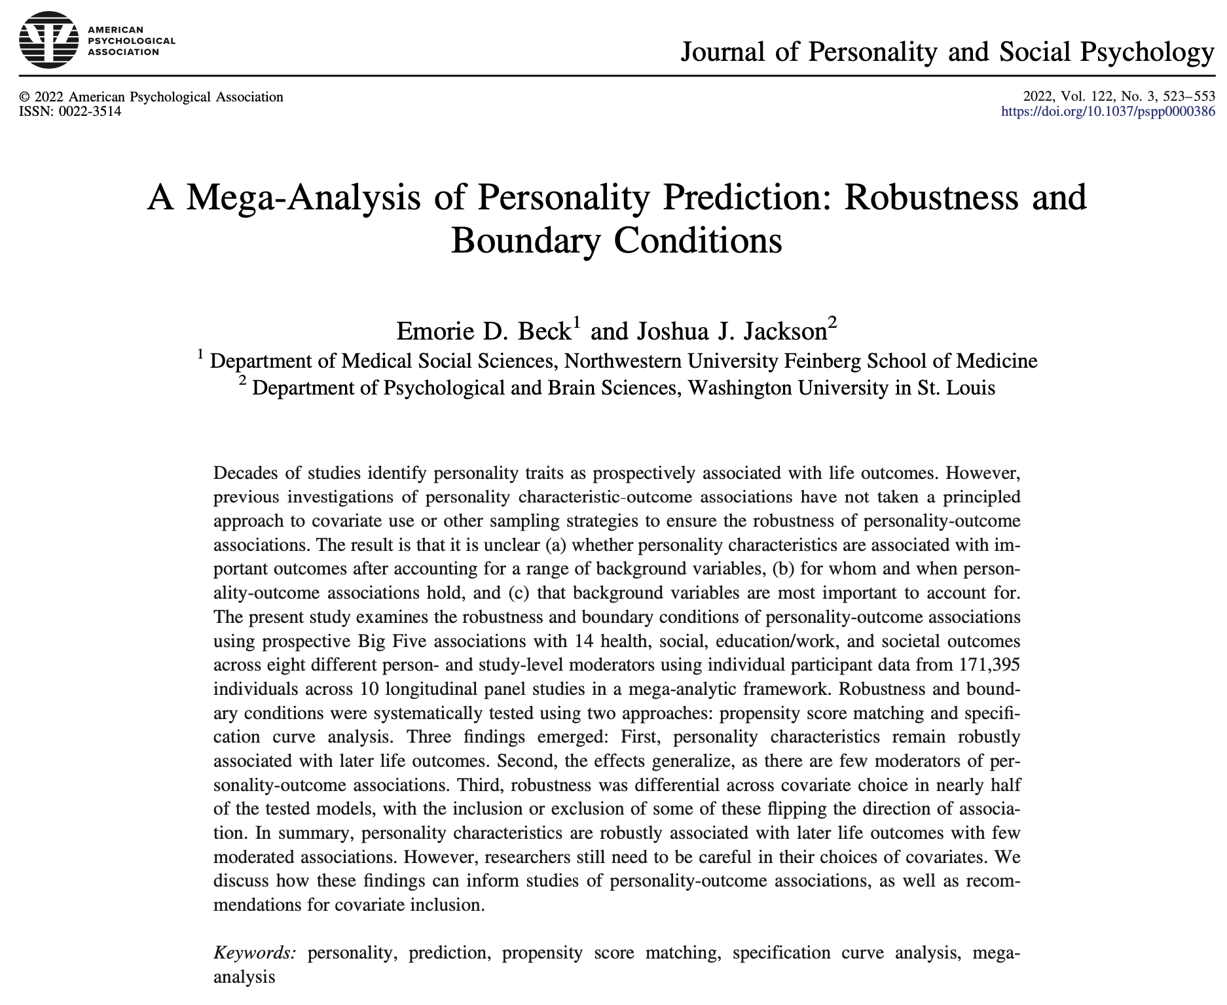
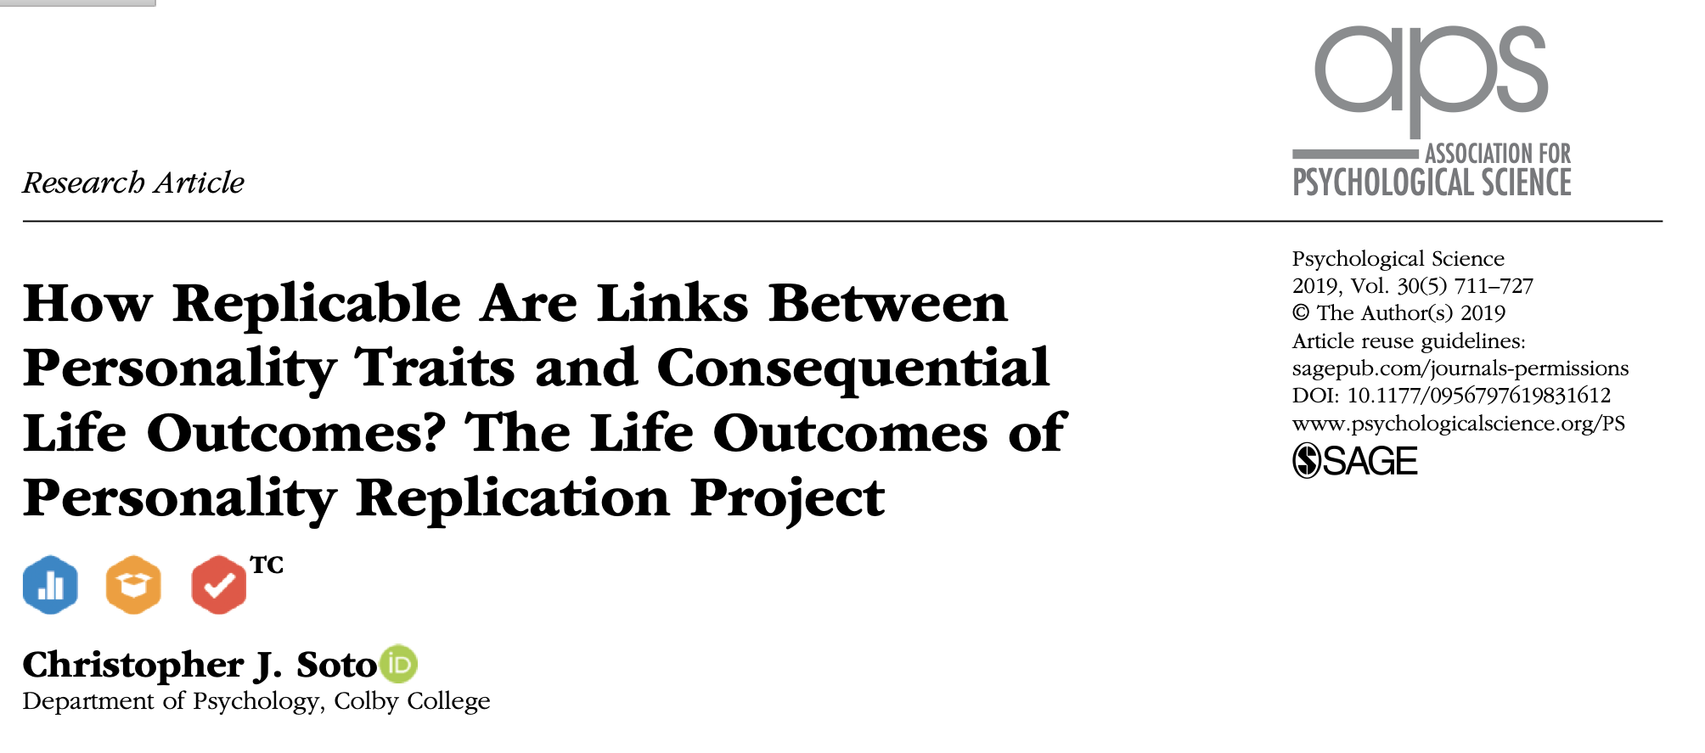
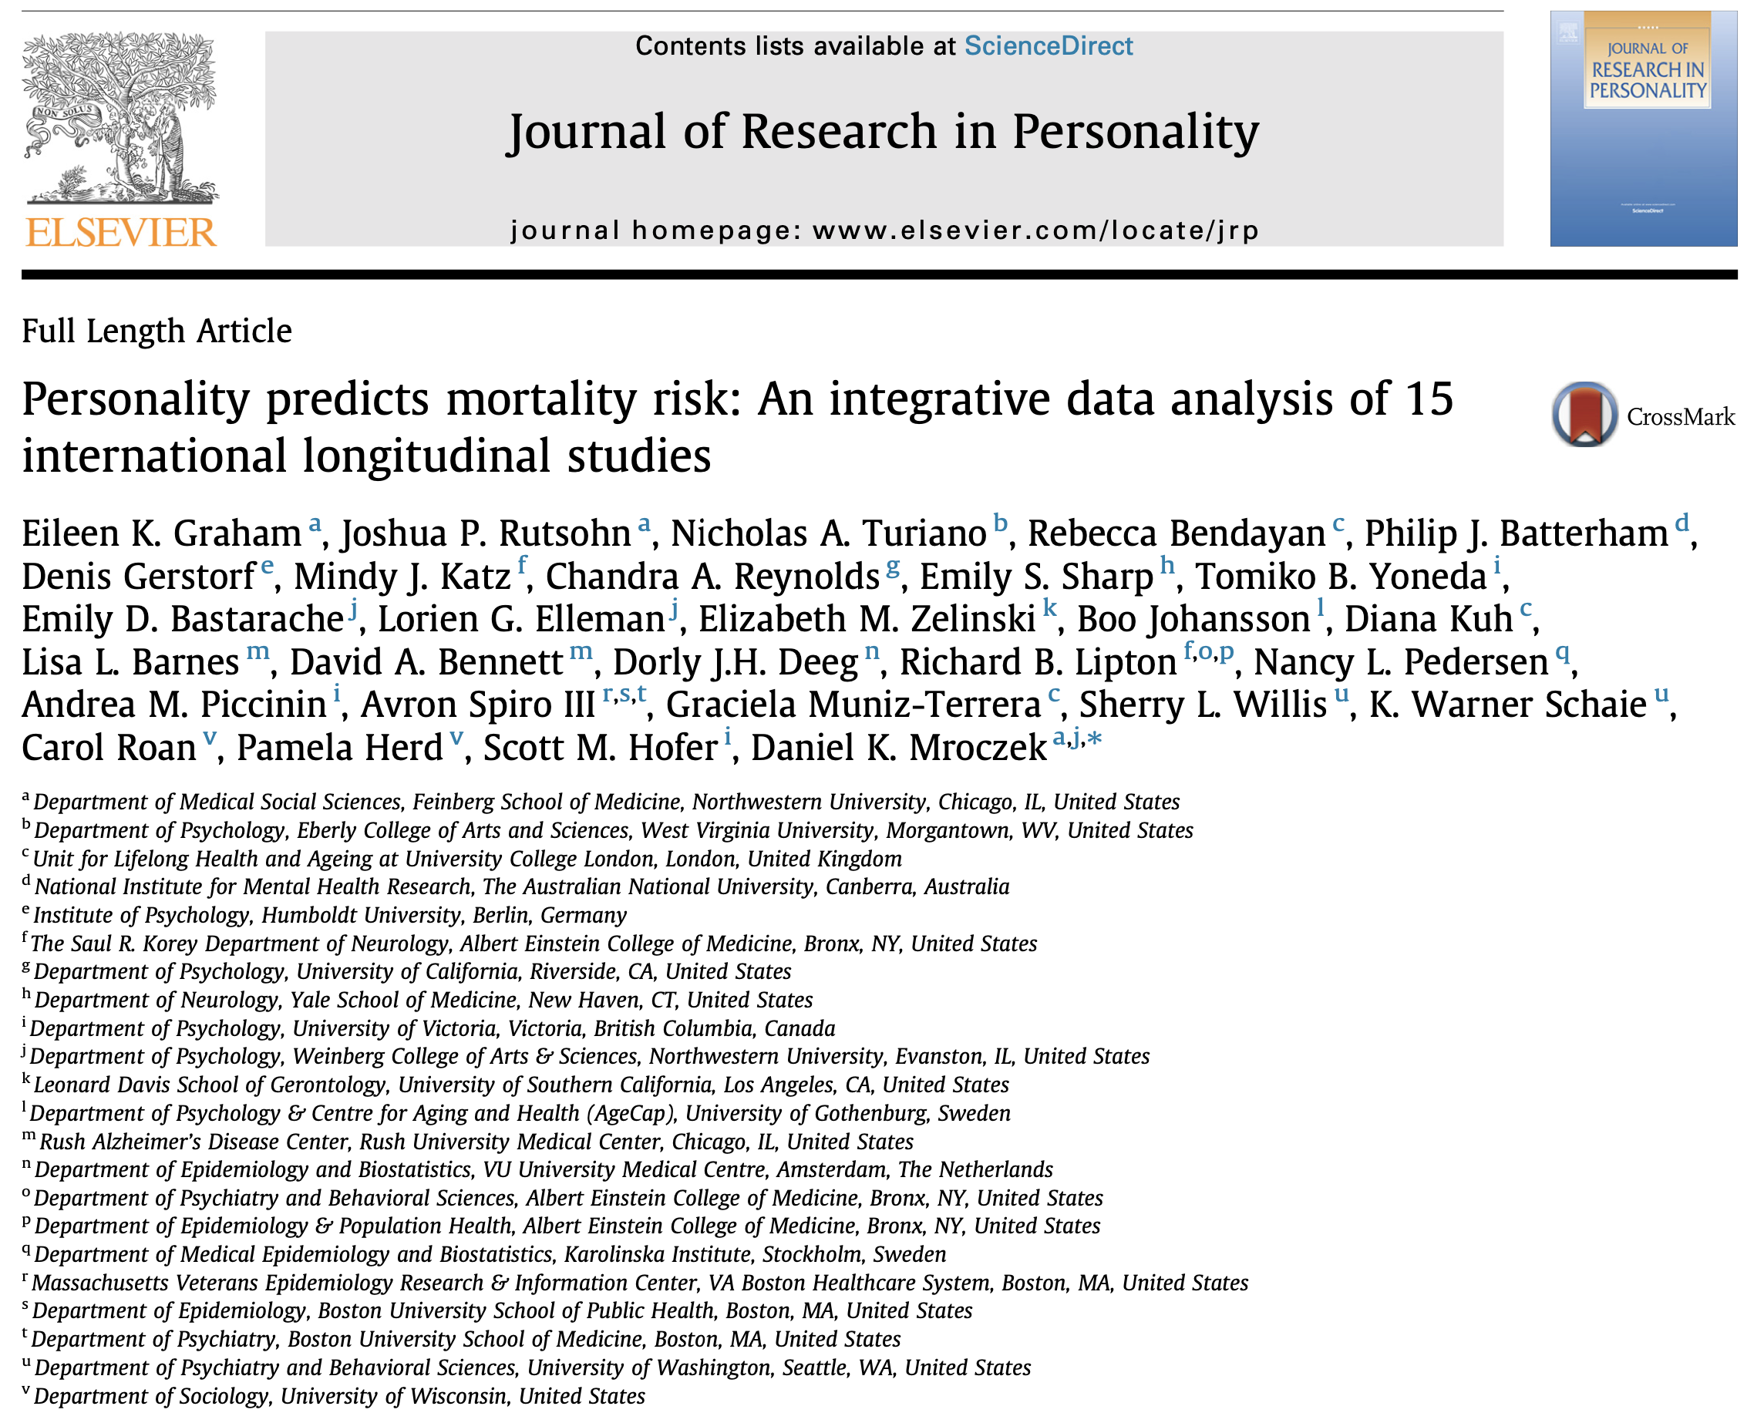

Slide 6
The Big 5
Extraversion
Agreeableness
Conscientiousness
Neuroticism
Openness
Direction
Magnitude
--
.6 SD
1 SD
-.8 SD
.4 SD
Timing
--
Lifespan
Lifespan
10-35
10-20
Roberts, Walton, & Viechtbauer, 2006
Notes:
Personality traits are stable but they also show change
That change varies in
direction, with …
magnitude, with …
and time, with …

Slide 7
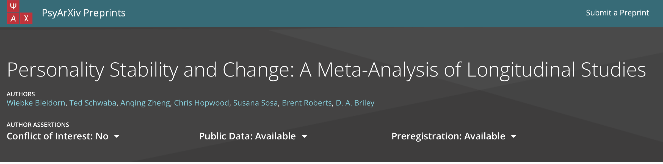

Slide 8
The Generalizability Problem
Nomothetic
Between-Person
Variable Centered
Idiographic
Person-Centered

Slide 9
The Generalizability Problem
Instead of growing impatient with the single case and hastening on to generalization, why should we not grow impatient with our generalizations and hasten to the internal pattern?” (Allport, 1961, p. 84)
Nomothetic
Between-Person
Variable Centered
Idiographic
Person-Centered

Slide 10
The Context Problem
e.g., Lewin, 1936

Slide 11
The Context Problem
e.g., Bronfenbrenner, 1979

Slide 12
The Time Problem
Age

Slide 13
The Time Problem
Time (Days)
Time (Years)

Slide 14


Slide 15
Aggregation
Questions
Time
Between-Person
Within-Person
Idiographic

Slide 16
Aggregation
Questions
Time
Variable-Centered
Description
Person-Centered
Prediction
Person-Specific
Explanation

Slide 17

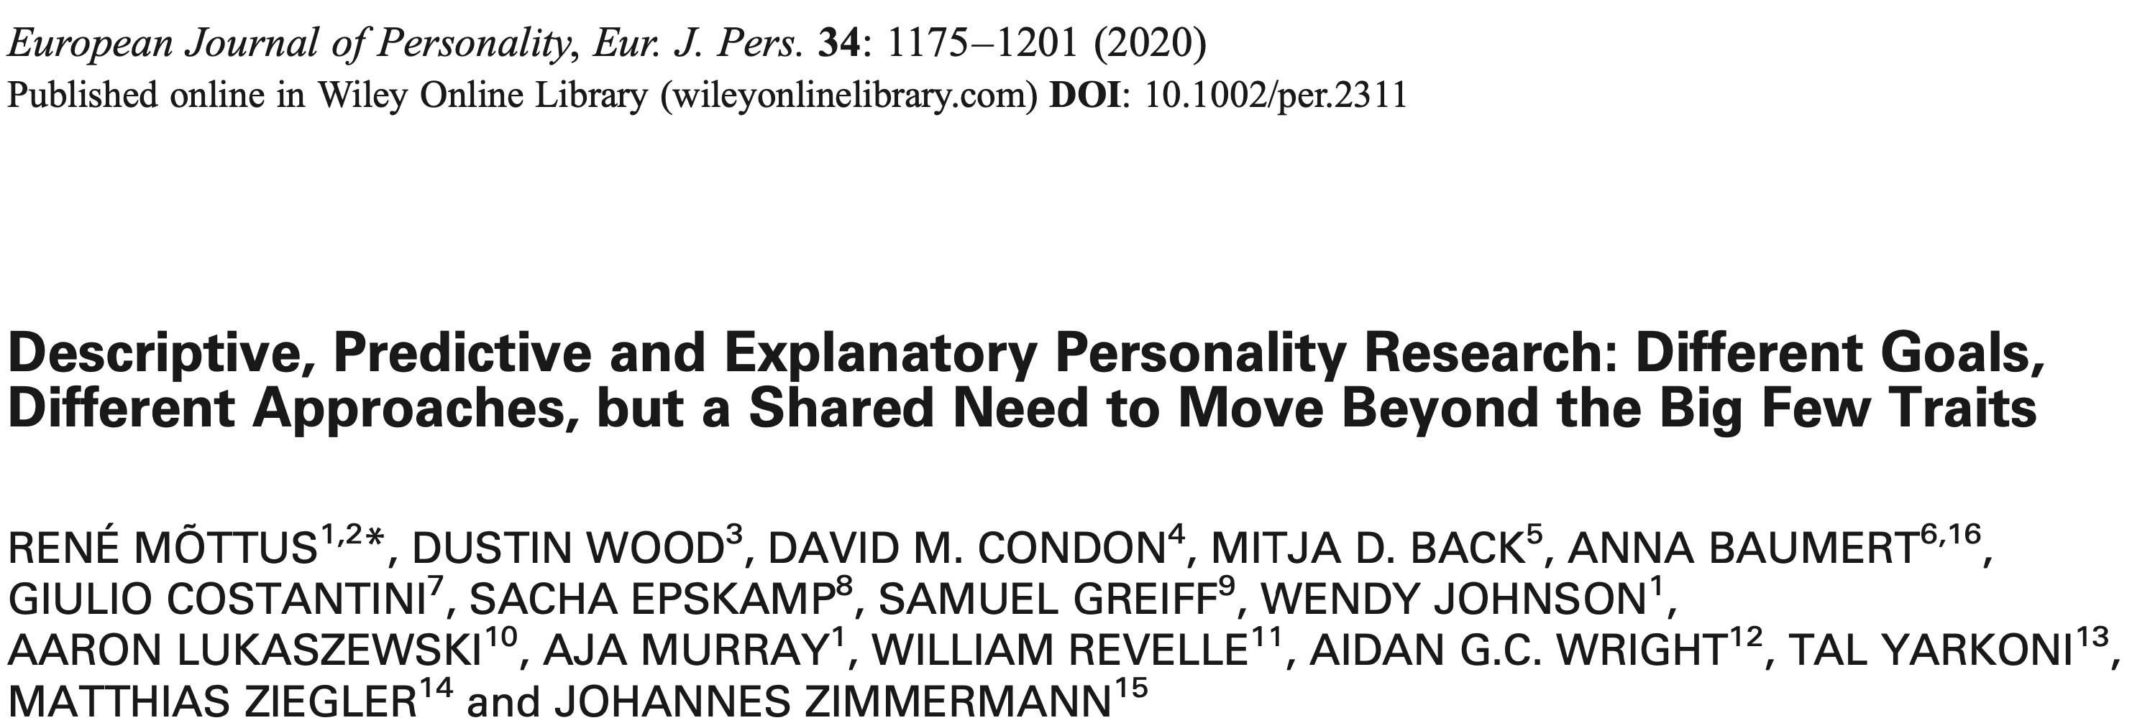

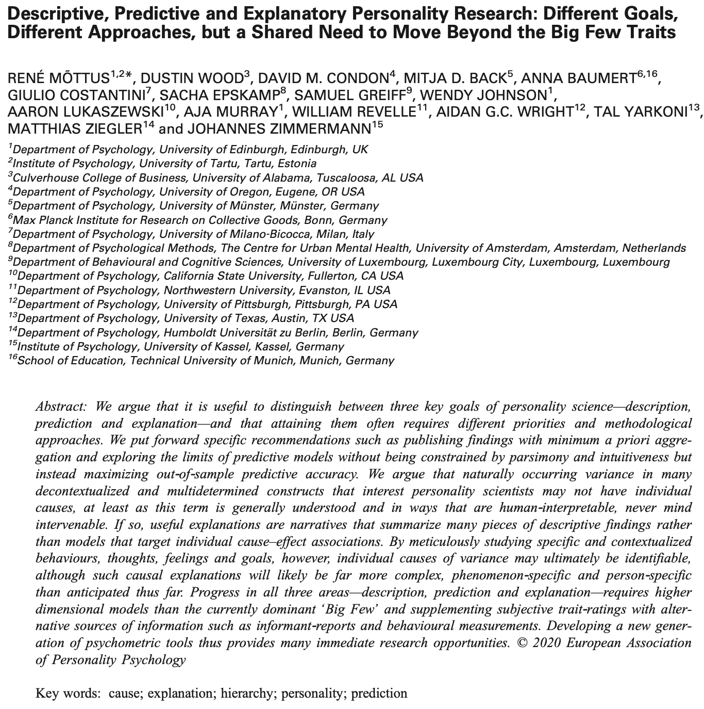


Slide 18
Aggregation
Questions
Time
Variable Centered
Description
Seconds, minutes, hours, days, weeks, months, years
.
.
.
Situations, contexts, cohorts, retrospective, etc.
Person Centered
Prediction
Person-Specific
Explanation

Slide 19
e.g., Cattell, 1943, 1946, 1957

Slide 20
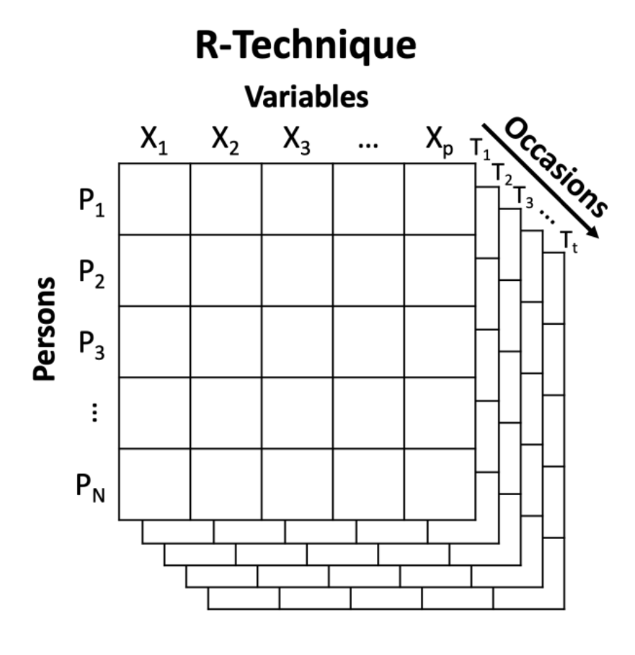
e.g., Cattell, 1943, 1946, 1957
Notes:
So I started looking for answers. And if I couldn’t find them in modern theories of personality, maybe I could find them in historical ones. And when I started reading Gordon Allport’s early work, I realized that there was a whole second track of personality psychology concerned exactly with the issues I was. For example, Allport defined personality as:

Slide 21
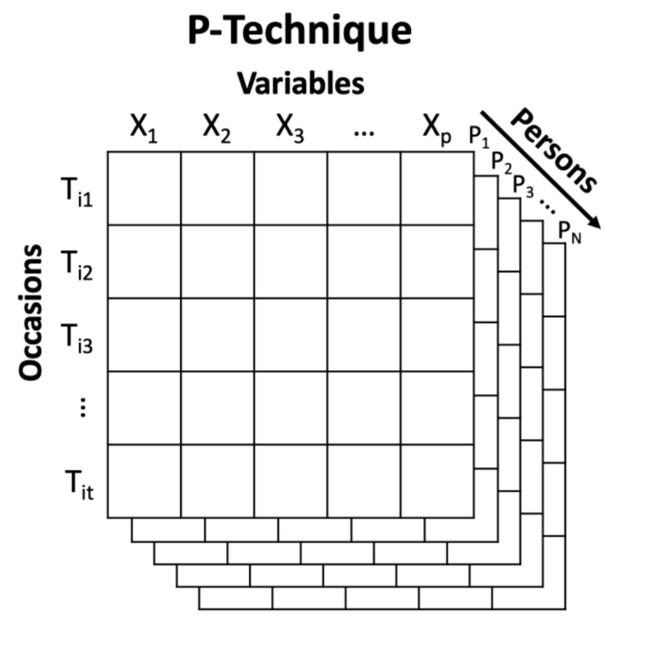
e.g., Cattell, 1943, 1946, 1957
Notes:
Although a huge and prominent theoretical development to this day, much of Cattell's work on P-technique remained much more limited until new data collection techniques made data with repeated assessments of individuals more common and easier to collect
In some ways, Cattell's data driven approaches to personality are the almost opposite of Allport's grand theorizing. And it wasn't until the latter half of the century that personality scientists set out to try to understand how to integrate these theories and methods

Slide 22


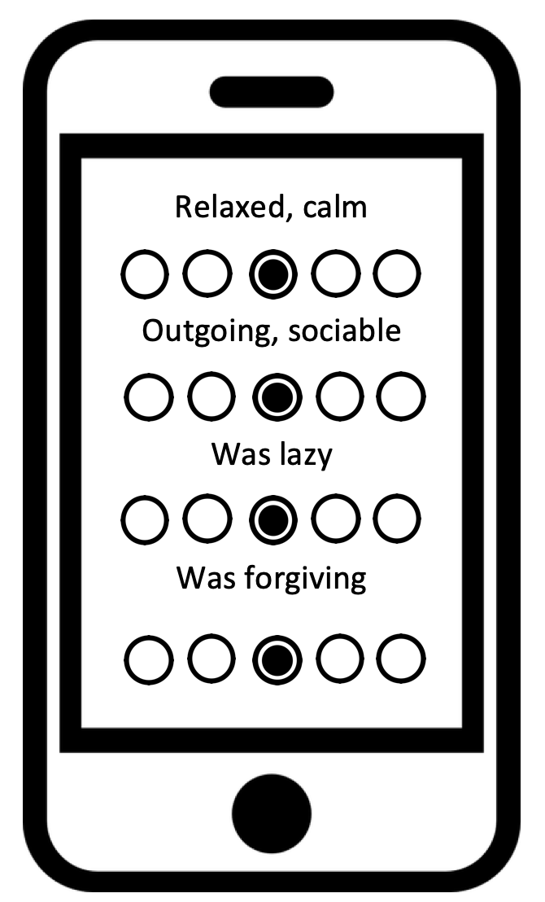




Basic Surveys
ESM / EMA
Mobile Sensing
Open-Ended Responses
e.g., Beck & Jackson, 2021c, JPSP
e.g., Beck & Jackson, 2020a, JPSP
e.g., Beck & Jackson, in press, Psych Sci
e.g., Beck & Jackson, 2021d, EJP
Notes:
To do so, I’ve used a variety of sources of data and data collection methods, including surveys, Experience Sampling Methdology, Passive or mobile sensing, and open-ended responses from both written and spoken questions or interviews. Moreover, I frequently use these both cross-sectionally and longitudinally

Slide 23
Between-Person / Nomothetic
Beck & Jackson (2021a, JPSP)
Beck, Condon & Jackson (revision submitted, EJP)
Jackson & Beck (2021a, JG:SB)
Yoneda et al. (in press, Neuropsychology)
Within-Person
Hill, Beck & Jackson (2021, JG:SB)⁺
Bollich, Beck, Hill, & Jackson (2021, JPSP)⁺
Eldesouky, Beck, Gross, & English (under review)⁺
*Cheung, *Beck, Thapa, & Jackson (under review)
Beck, Scott, et al. (in prep)
Idiographic
Beck & Jackson (2020a, JPSP)^{X}
Beck & Jackson (2020b, CDPS)
Beck & Jackson (under revision, PS)
Beck & Jackson (2021b, EJP)
Beck & Jackson, (2021c, JPA)
Jackson & Beck (2021b, JP)
Frumkin et al. (2020, PR)
Piccirillo, Beck et al. (2019, BT)
Methods
Nosek, Beck et al. (2019, TiCS)
Beck & Jackson (2021c, JPA)
Beck et al. (2021, PersSci)
Beck, Willroth, et al. (in prep)
Beck & Jackson (2020a, JPSP)
Beck & Jackson (2021a, JPSP)
* = Equal contributions, + = cross-listed with B/w person, x = cross-listed with within-person
Notes:
So what I want to do today is step through examples of how to answer these questions at different levels of aggregation with an emphasis on those for idiographic approaches, where less research has been conducted

Slide 24
The Theory-Method Gap
Personality is what personality tests test.
Notes:
But defining the categories of questions and levels of aggregation is only a minimal part of the scientific enterprise, although a very important one.
Just as important is the theoretical lens and approaches that give rise to the questions researchers ask and try to answer and the methods used to answer them. But one of these without the other can render a fantastic analysis uninterpretable or in no way advance or test propositions of an important theoretical model.

Slide 25
The Theory-Method Gap
Dynamics
Notes:
But defining the categories of questions and levels of aggregation is only a minimal part of the scientific enterprise, although a very important one.
Just as important is the theoretical lens and approaches that give rise to the questions researchers ask and try to answer and the methods used to answer them. But one of these without the other can render a fantastic analysis uninterpretable or in no way advance or test propositions of an important theoretical model.

Slide 26
“Personality is the dynamic organization within the individual of those psychophysical systems that determine his unique adjustments to the environment.”
-Allport, 1937, p.

Slide 27
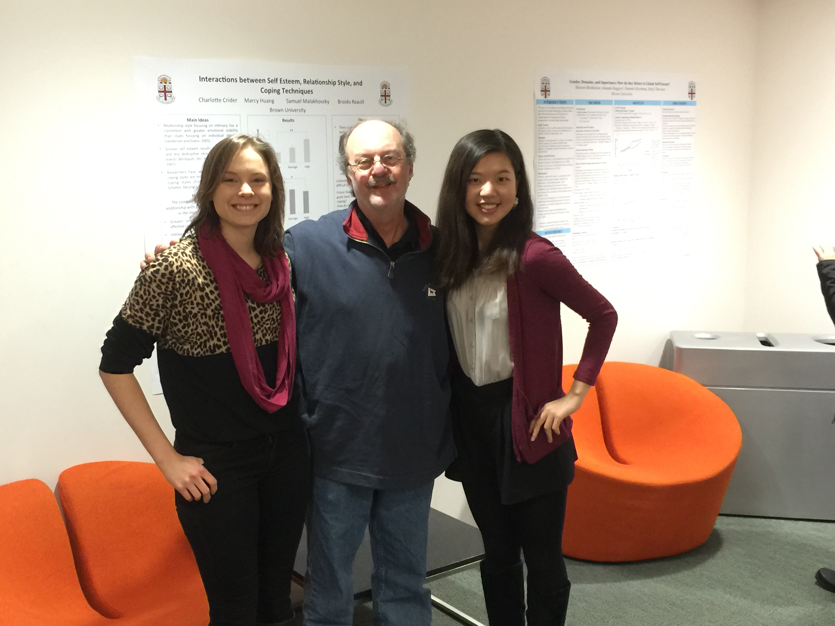

if
…
then
Context
Situation perception
Experience
Etc.
Behavior
Experience
Etc.
e.g., Mischel & Shoda, 2005; Wright & Mischel, 1987;
Shoda, Mischel, & Wright, 1993; Mischel, 1973
Notes:
Although the data box remains an important motivator for thinking about the data we collect and how it can be understood, it is not itself a theoretical model. But in the latter half of the 20th century, work by Jack Wright, yuichi Shoda, and Walter Mischel offered a model for understanding the interplay of psychological and situational phenomena within an individual.
First, some of Jack's early work considered personality as sets of so-called if...then contingencies, which captured probabilistic relationships between the physical and psychological contexts individuals inhabited and the behaviors and experiences they enact or have. So rather than seeing personality as aggregated across situations, contexts, and time, personality was seen as the profile of behaviors and experiences most typical in response to situational contexts. In other words, situations were an important and critical part of personality, not a nuissance to how we think about tendencies.

Slide 28
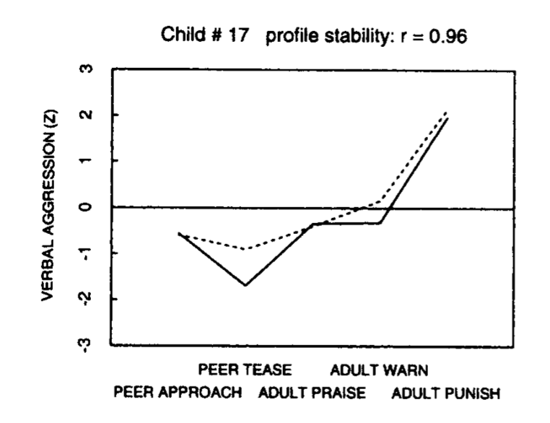
e.g., Mischel & Shoda, 2005; Wright & Mischel, 1987;
Shoda, Mischel, & Wright, 1993; Mischel, 1973
Notes:
Although the data box remains an important motivator for thinking about the data we collect and how it can be understood, it is not itself a theoretical model. But in the latter half of the 20th century, work by Jack Wright, yuichi Shoda, and Walter Mischel offered a model for understanding the interplay of psychological and situational phenomena within an individual.
First, some of Jack's early work considered personality as sets of so-called if...then contingencies, which captured probabilistic relationships between the physical and psychological contexts individuals inhabited and the behaviors and experiences they enact or have. So rather than seeing personality as aggregated across situations, contexts, and time, personality was seen as the profile of behaviors and experiences most typical in response to situational contexts. In other words, situations were an important and critical part of personality, not a nuissance to how we think about tendencies.

Slide 29
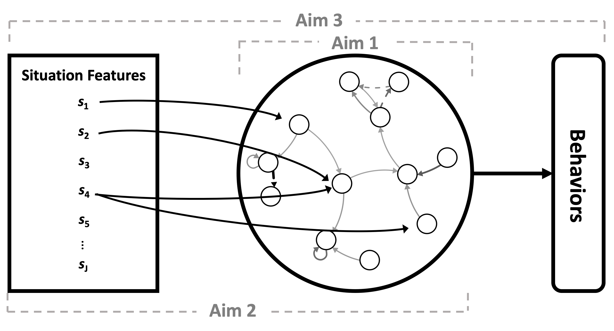
A Cognitive Affective Processing System (CAPS)
e.g., Mischel & Shoda, 2005; Wright & Mischel, 1987;
Shoda, Mischel, & Wright, 1993; Mischel, 1973
Notes:
Second, Walter and Yuichi's Cognitive Affective Personality System brought if...then contingencies together in a meta-model using concepts from dynamical systems theory. Although the nuances of the model are beyond the scope of todays talk, the main features are that personality can be captured as a system of mediating cognitive affective units and their relationships to one another. But these relationships don't unfold in a vacuum. Rather, situational features and perceptions activate specific cognitive affective units, whose interactions with each other, in turn, dynamically produce behaviors and experiences. Such a model both describes the personality of an individual but also explains patterns of behaviors.

Slide 30
Today’s Agenda
Talk
Seminar
Workshop
Linking Theory and Methods Using Dynamics
Revisiting Assessment and Its Link to Dynamics
Applying (some) Dynamic Models to Real Data
CAPS
Methods from the Talk
Reimagining personality structure
Deconstructing Definitions
(Basic) Time Series
Core Dynamics Metrics
Considering the time/context problem
Small Group Work
Multilevel “Process” Models
Revisiting the Person-Situation Debate: A New Approach to Prediction
Presentation and Integration
(Applied) Machine Learning
Dynamic EGA
Estimating the Robustness of prospective personality trait-outcome associations
(Maybe) Growth Models

Slide 31


Slide 32
Today’s Agenda
Talk
Linking Theory and Methods Using Dynamics
CAPS
Reimagining personality structure
Considering the time/context problem
Revisiting the Person-Situation Debate: A New Approach to Prediction
Estimating the Robustness of prospective personality trait-outcome associations

Slide 33





Methods
Individual Structure | Longitudinal Dynamics | Personalized Prediction | Trait Prediction
2 years of ESM responses from the Personality and Interpersonal Roles Study (PAIRS)
N = 372 Wash U undergrads, total assessments N = 17,715
Measures
9 items from the Big Five Inventory (BFI)
Procedure
4 assessments / day for 15 days
Modeling
Graphical vector autoregression
Beck & Jackson (2020a, JPSP; 2021b, EJP)
Notes:
Graphical VAR results in a regularized matrix of partial correlation coefficients whose patterns can be visualized as a network for each participant separately

Slide 34
Individual Structure | Longitudinal Dynamics | Personalized Prediction | Trait Prediction
E
A
C
N
O
E
A
C
N
O
time
1 | 4 | 2 | 3 | 2 | 4
2 | 2 | 3 | 4 | 1 | 4
3 | 3 | 3 | 2 | 2 | 4
4 | 3 | 1 | 3 | 2 | 3
5 | 4 | 4 | 3 | 2 | 2
6 | 4 | 1 | 2 | 3 | 4
7 | 2 | 2 | 2 | 2 | 1
8 | 4 | 2 | 3 | 3 | 4
9 | 3 | 2 | 2 | 1 | 2
10 | 4 | 2 | 3 | 3 | 3
11 | 3 | 1 | 3 | 2 | 5
E
0.02
-0.05 | 0.08
0.64 | -0.12 | -0.10
0.26 | -0.27 | 0.43 | 0.07
A
C
N
O
Contemporaneous: Within Time-Points
X_{it}←→X_{jt}
Notes:
Experience sampling data are also called multivariate time series data. Essentially, you end up with a data matrix that looks like this, where instead of each row indicating responses from a different individual, the rows indicate momentary observations from a single individual on a numbe rof trait constructs.
Much as how we can look at how trait constructs are related to one another across people, these data allow us to ask how they are related within a person idiographically.

Slide 35
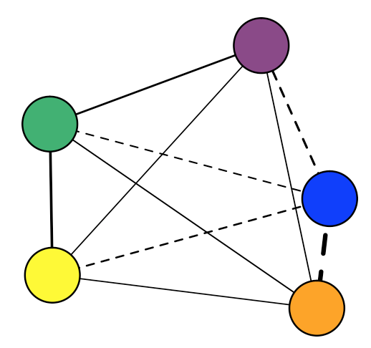
Individual Structure | Longitudinal Dynamics | Personalized Prediction | Trait Prediction
E
A
C
N
O
time
1 | 4 | 2 | 3 | 2 | 4
2 | 2 | 3 | 4 | 1 | 4
3 | 3 | 3 | 2 | 2 | 4
4 | 3 | 1 | 3 | 2 | 3
5 | 4 | 4 | 3 | 2 | 2
6 | 4 | 1 | 2 | 3 | 4
7 | 2 | 2 | 2 | 2 | 1
8 | 4 | 2 | 3 | 3 | 4
9 | 3 | 2 | 2 | 1 | 2
10 | 4 | 2 | 3 | 3 | 3
11 | 3 | 1 | 3 | 2 | 5
Contemporaneous: Within Time-Points X_{it}←→X_{jt}
Notes:
And these correlations can be visualized as networks, whose properties can be analyzed to tell us something about the structure of individual differences

Slide 36
Individual Structure | Longitudinal Dynamics | Personalized Prediction | Trait Prediction

Slide 37
Individual Structure | Longitudinal Dynamics | Personalized Prediction | Trait Prediction
Idiographic
Person-Centered
e.g., Beck & Jackson, 2020a, JPSP; 2020b, CDPS
Notes:
The second, an idiographic approach, asks questions about the structure and development of personality at the level of a single person relative to only him or herself. Despite a small number of studies examining the individual level structure of personality, idiographic studies of personality have been much more limited

Slide 38
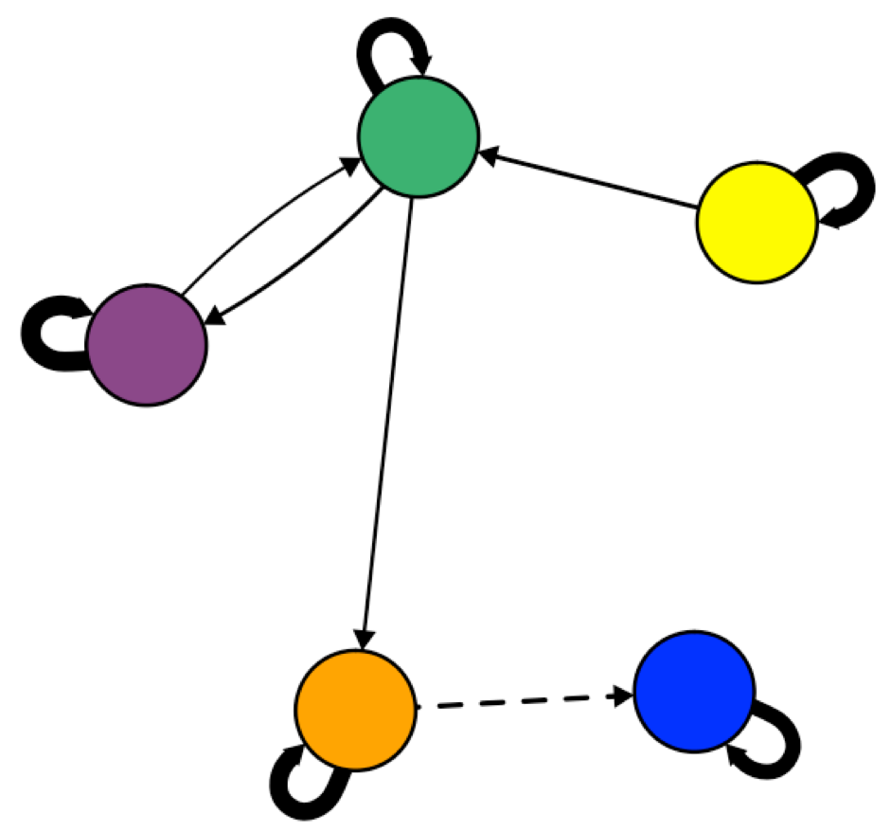
Individual Structure | Longitudinal Dynamics | Personalized Prediction | Trait Prediction
Idiographic
Notes:
But network models have great potential in personality. When coupled with intensive longitudinal data collection, such as that collected using experience sampling or daily diary measures, network models can also be created for individual people, allowing for unique interdependencies among responses.
Such an approach has the advantage of allowing us to model personality closer to the level of a person. In other words, we can model unique relationships among the individuals self-reported observable and unobservable experiences, which may finally allow us to answer the question of whether idiographic assessments of personality do stack up to the power of nomothetic assessments.

Slide 39
RESULTS
Aim 1

Slide 40
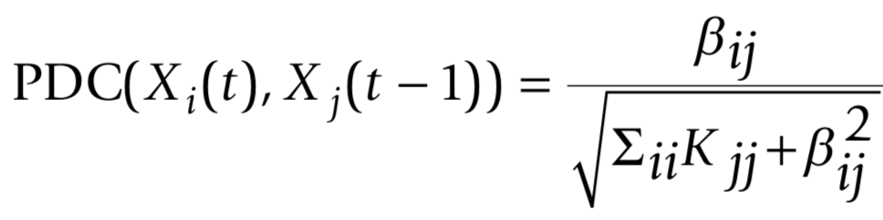
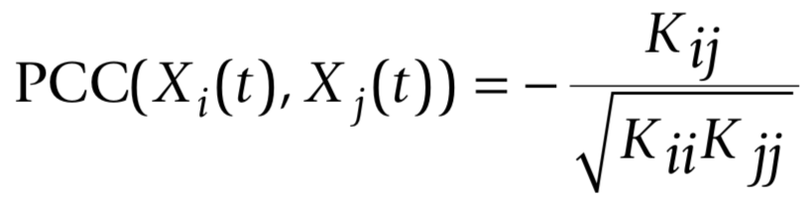
Contexts | Individuals | Dynamics | Contexts, Individuals, & Dynamics | Future Directions
Regularized Graphical Vector Autoregressive Models
X₁₁
X₁₂
X₁₃
. . .
X_{1j}
1
X₁₂
X₁₃
. . .
X_{1j}
X₂₁
X₂₂
X_{2j}
X₂₁
1
X_{2j}
X₃₁
X_{3j}
X₃₁
X_{3j}
. . .
. . .
. . .
. . .
. . .
. . .
X_{i1}
. . .
X_{ij}
X_{i1}
. . .
1

Slide 41
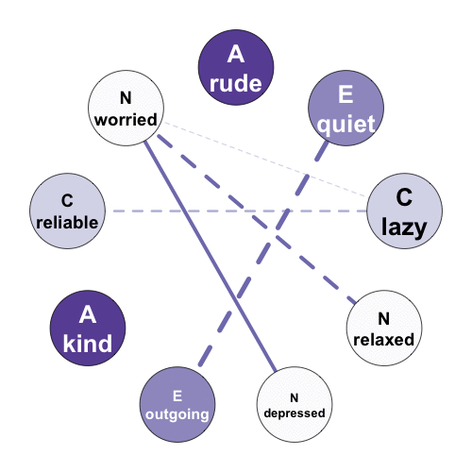
The structures differ across people.
But do they show expected longitudinal consistency?
Beck & Jackson (2020a, JPSP)

Slide 42
The structures differ across people.
But do they show expected longitudinal consistency?
Beck & Jackson (2020a, JPSP; 2021b, EJP)

Slide 43
Individual Structure | Longitudinal Dynamics | Personalized Prediction | Trait Prediction
Beck & Jackson (2020a, JPSP)
Notes:
In addition, we can also look at the structure of an individual’s personality at separate waves, collected one year apart, testing for the degree of consistency and change across that time span

Slide 44
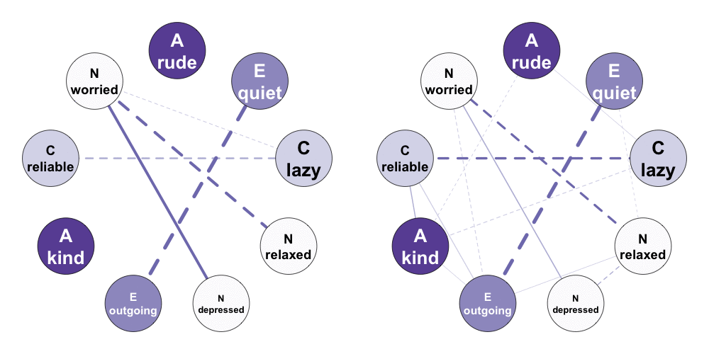
Individual Structure | Longitudinal Dynamics | Personalized Prediction | Trait Prediction
Beck & Jackson (2020a, JPSP)
Notes:
And we see that some individuals show similar structures over time while others appear to show weaker similarity

Slide 45
Individual Structure | Longitudinal Dynamics | Personalized Prediction | Trait Prediction
Beck & Jackson (2020a, JPSP)
Notes:
To quantify this, we can actually correlate the regularized partial correlation matrices to see their association across waves, with higher correlations indicating more similar patterns of associations

Slide 46
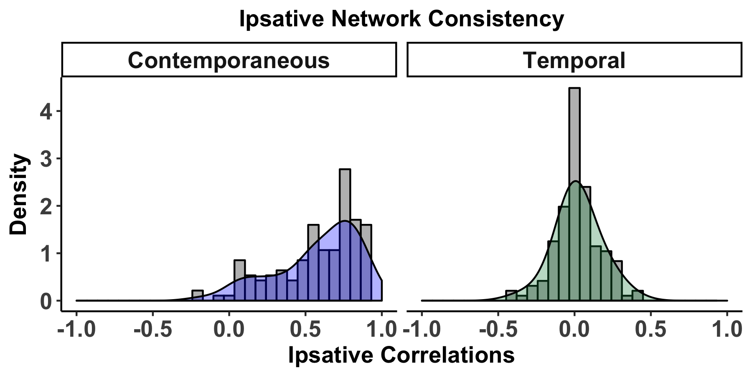
Individual Structure | Longitudinal Dynamics | Personalized Prediction | Trait Prediction
How consistent is idiographic personality across two
years?
Beck & Jackson (2020a, JPSP)
Notes:
And when we do this for each individual, we can combine the results into a density distribution that evidences the overall pattern.

Slide 47
Individual Structure | Longitudinal Dynamics | Personalized Prediction | Trait Prediction
How consistent is idiographic personality across two
years?
Idiographic Personality is consistent over two years.
Beck & Jackson (2020a, JPSP)

Slide 48
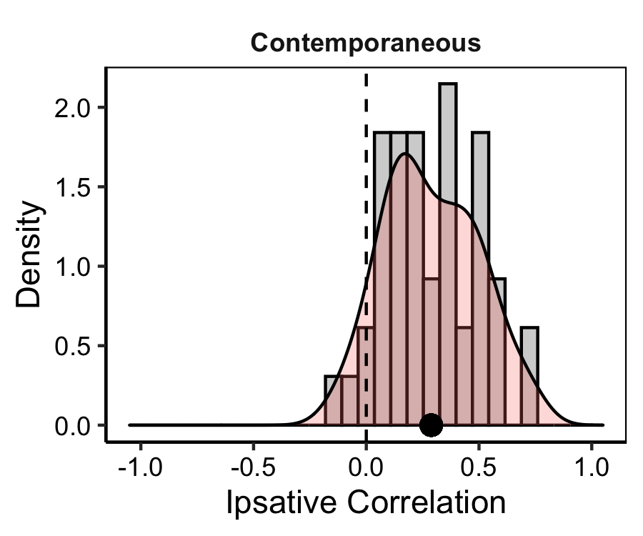
Individual Structure | Longitudinal Dynamics | Personalized Prediction | Trait Prediction
How consistent is idiographic personality across two
years?
Idiographic Personality is consistent over two years AND global events.
Beck & Jackson (2021b, EJP)

Slide 49
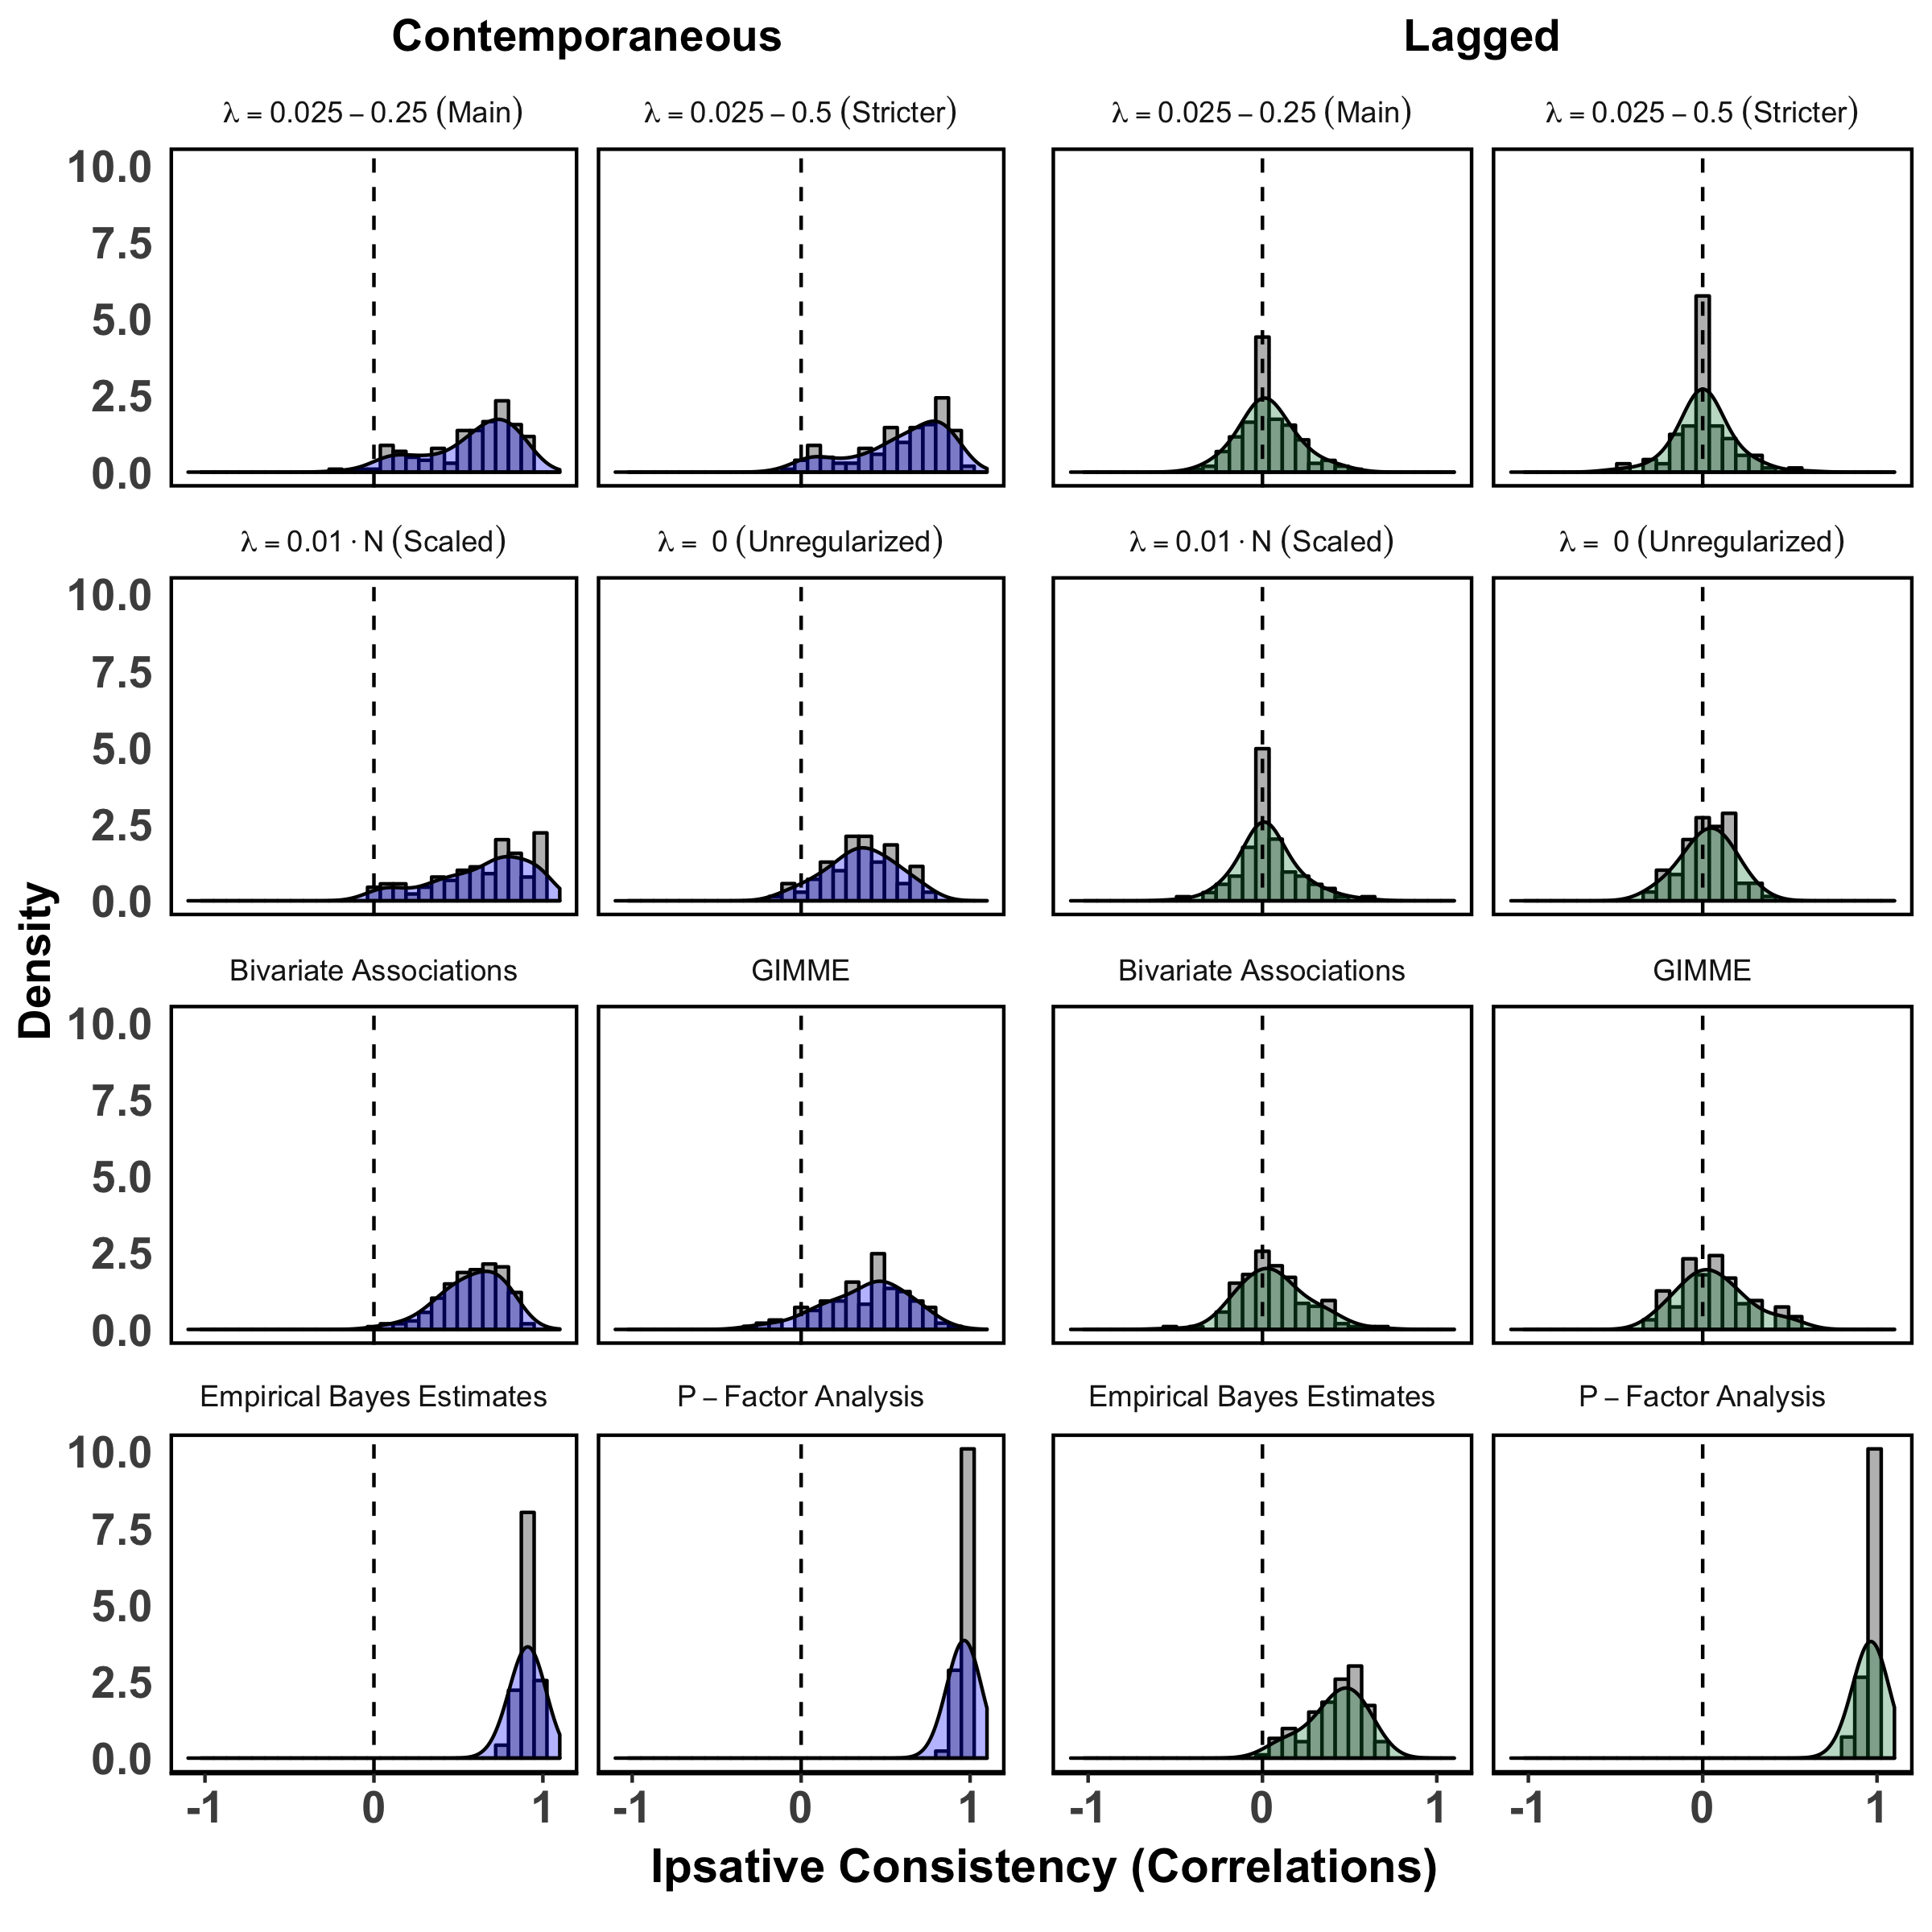
Individual Structure | Longitudinal Dynamics | Personalized Prediction | Trait Prediction
Beck & Jackson (2020a, JPSP; 2021b, EJP)

Slide 50
Individual Structure | Longitudinal Dynamics | Personalized Prediction | Trait Prediction
Beck & Jackson (2020a, JPSP; 2021b, EJP)

Slide 51
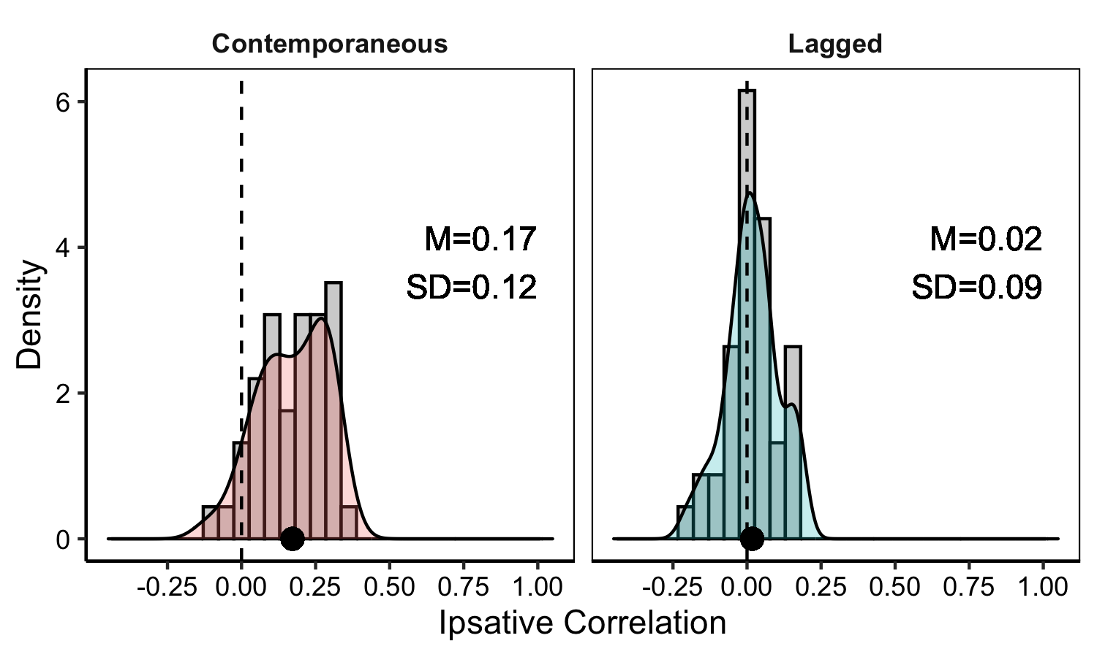
Individual Structure | Longitudinal Dynamics | Personalized Prediction | Trait Prediction
Before and after the onset of the COVID-19 pandemic?
Beck & Jackson (2020a, JPSP; 2021b, EJP)
Notes:
Before the COVID-19 pandemic, I had been conducting a longitudinal ESM study called the Intentional Personality Change Study. But due to COVID, the intentional change part got paused to instead track changes that occurred in individual’s personalities following the COVID-19 pandemic.

Slide 52
Individual Structure | Longitudinal Dynamics | Personalized Prediction | Trait Prediction
Before and after the onset of the COVID-19 pandemic?
Idiographic Personality is relatively consistent across a global event.
Beck & Jackson (2020a, JPSP; 2021b, EJP)

Slide 53
Today’s Agenda
Talk
Idiographic personality structures are:
Unique (i.e. differ across people).
Relatively consistent over time.
Relatively consistent across global events.
Linking Theory and Methods Using Dynamics
CAPS
Reimagining personality structure
Considering the time/context problem
Revisiting the Person-Situation Debate: A New Approach to Prediction
Estimating the Robustness of prospective personality trait-outcome associations

Slide 54
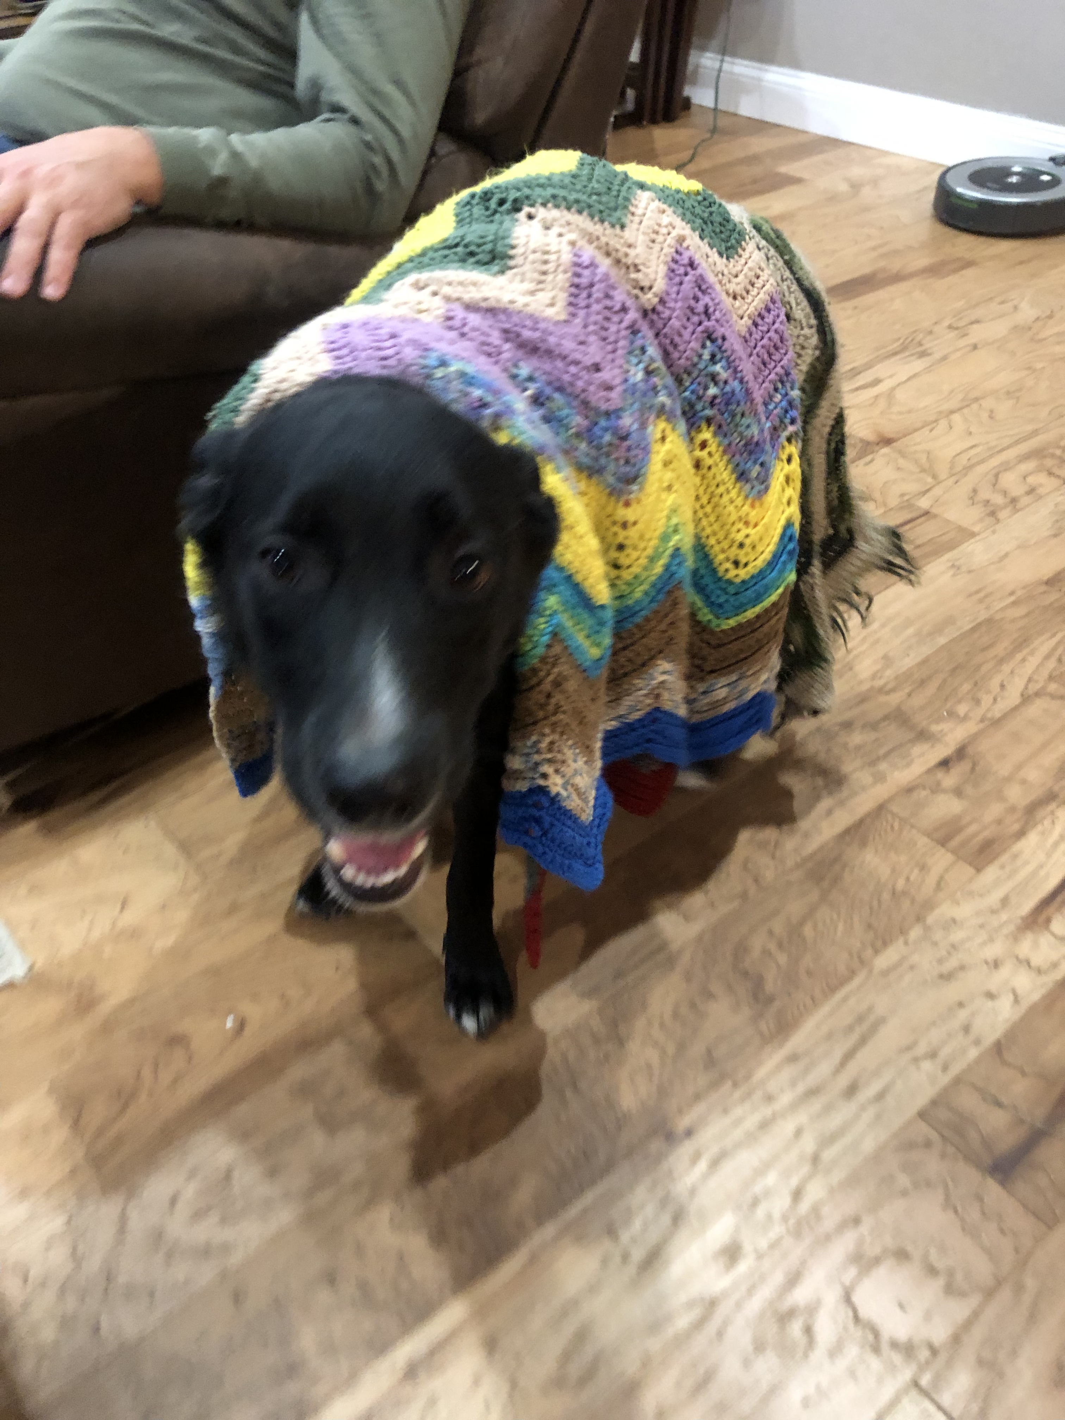

Slide 55
Today’s Agenda
Talk
Linking Theory and Methods Using Dynamics
CAPS
Reimagining personality structure
Considering the time/context problem
Revisiting the Person-Situation Debate: A New Approach to Prediction
Estimating the Robustness of prospective personality trait-outcome associations

Slide 56
Individual Structure | Longitudinal Dynamics | Personalized Prediction | Trait Prediction
Extraversion
Agreeableness
Conscientious-ness
Neuroticism
Openness
Between-Person
Variable Centered
Idiographic
Person-Centered

Slide 57
Individual Structure | Longitudinal Dynamics | Personalized Prediction | Trait Prediction
Strong Theoretical Models
Life Satisfaction
Rich longitudinal data
Unique patterns ignored
Health
Income
Housing
Job
Relat-ionship
Domain Satisfaction
*Cheung, *Beck, Thapa, & Jackson (under review)
Notes:
So to talk about how personality unfolds over time and why it's important to consider these individual-level, idiographic structures of personality and not just look at average structures, we're going to shift gears a bit to talk about life satisfaction and satisfaction in domains of life.
Life satisfaction offers a really unique opportunity to work through why disaggragating individual's patterns from average patterns across a population because there is rich theoretical thinking about the patterns and their direction.

Slide 58
Individual Structure | Longitudinal Dynamics | Personalized Prediction | Trait Prediction
Bottom-Up
(Situational)
Life Satisfaction
Diener, 1984
Health
Income
Housing
Job
Relat-ionship
Domain Satisfaction
*Cheung, *Beck, Thapa, & Jackson (under review)
Notes:
So to talk about how personality unfolds over time and why it's important to consider these individual-level, idiographic structures of personality and not just look at average structures, we're going to shift gears a bit to talk about life satisfaction and satisfaction in domains of life.
Life satisfaction offers a really unique opportunity to work through why disaggragating individual's patterns from average patterns across a population because there is rich theoretical thinking about the patterns and their direction.

Slide 59
Individual Structure | Longitudinal Dynamics | Personalized Prediction | Trait Prediction
Top-Down
(Dispositional)
Life Satisfaction
Diener, 1984
Health
Income
Housing
Job
Relat-ionship
Domain Satisfaction
*Cheung, *Beck, Thapa, & Jackson (under review)

Slide 60
Individual Structure | Longitudinal Dynamics | Personalized Prediction | Trait Prediction
Bidirectional
Life Satisfaction
Kuykendall, Tay, & Ng, 2015
Health
Income
Housing
Job
Relat-ionship
Domain Satisfaction
*Cheung, *Beck, Thapa, & Jackson (under review)
Notes:
f

Slide 61
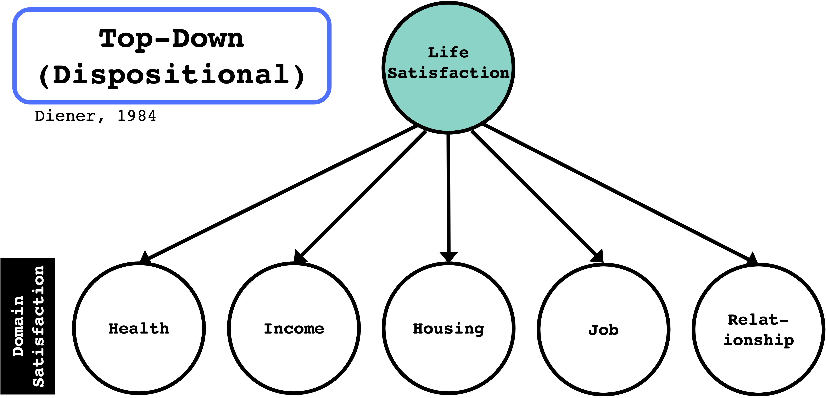

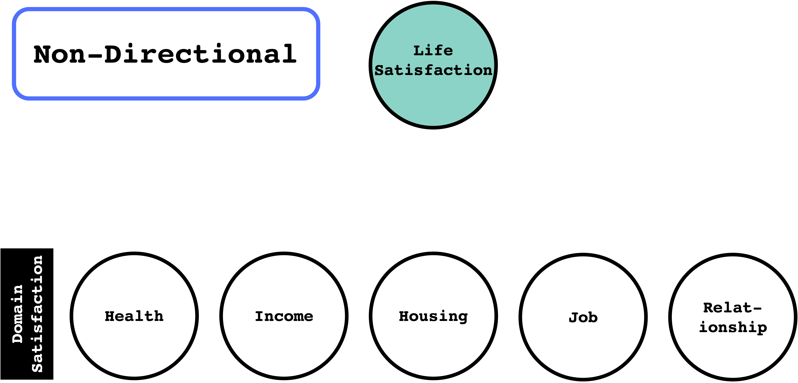
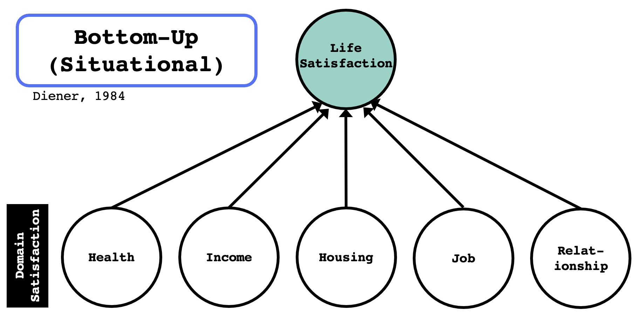

Slide 62
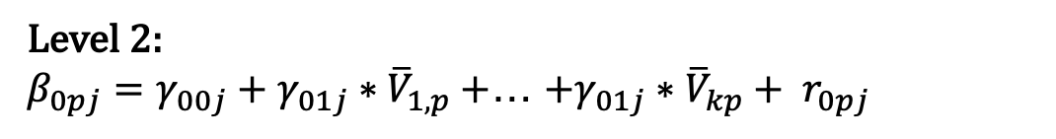
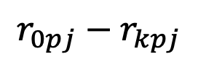
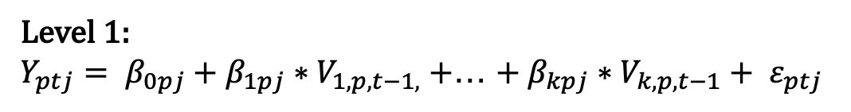
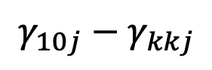
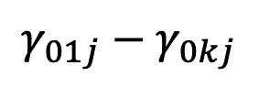
Individual Structure | Longitudinal Dynamics | Personalized Prediction | Trait Prediction
GSOEP
HILDA
SHP
BHPS
LISS
Multilevel VAR(1) Models
Between-Person Effects
(Level 2)
Epskamp et al., 2018
$$γ_{01j}−γ_{0kj}$$
Level 1:
$Y_{ptj}= β_{0pj}+β_{1pj}∗V_{1,p, t−1,}+$… $+ β_{kpj}∗V_{k,p, t−1}+ ε_{ptj}$
Level 2:
$β_{0pj}=γ_{00j}+γ_{01j}∗{\overline{V}}_{1,p}+$… $+γ_{01j}∗{\overline{V}}_{kp}+ r_{0pj}$
Within-Person Effects
(Level 1)
$$γ_{10j}−γ_{kkj}$$
…
…
…
…
…
…
…
$β_{kpj}=γ_{k0j}+γ_{k1j}∗{\overline{V}}_{p,1}+$… $+γ_{kkj}∗{\overline{V}}_{pj}+ r_{kpj}$
Person-Specific Effects
(Level 2 random effects)
$$r_{0pj}−r_{kpj}$$
*Cheung, *Beck, Thapa, & Jackson (under review)

Slide 63
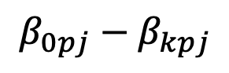
Individual Structure | Longitudinal Dynamics | Personalized Prediction | Trait Prediction
GSOEP
HILDA
SHP
BHPS
LISS
Multilevel VAR(1) Models
Between-Person Effects
(Level 2)
Epskamp et al., 2018
$$γ_{01j}−γ_{0kj}$$
Level 1:
$Y_{ptj}= β_{0pj}+β_{1pj}∗V_{1,p, t−1,}+$… $+ β_{kpj}∗V_{k,p, t−1}+ ε_{ptj}$
Level 2:
$β_{0pj}=γ_{00j}+γ_{01j}∗{\overline{V}}_{1,p}+$… $+γ_{01j}∗{\overline{V}}_{kp}+ r_{0pj}$
Within-Person Effects
(Level 1)
$$γ_{10j}−γ_{kkj}$$
…
…
…
…
…
…
…
$β_{kpj}=γ_{k0j}+γ_{k1j}∗{\overline{V}}_{p,1}+$… $+γ_{kkj}∗{\overline{V}}_{pj}+ r_{kpj}$
Person-Specific Effects
(Level 2 random effects)
$$β_{0pj}−β_{kpj}$$
*Cheung, *Beck, Thapa, & Jackson (under review)

Slide 64
RESULTS
Aim 2

Slide 65
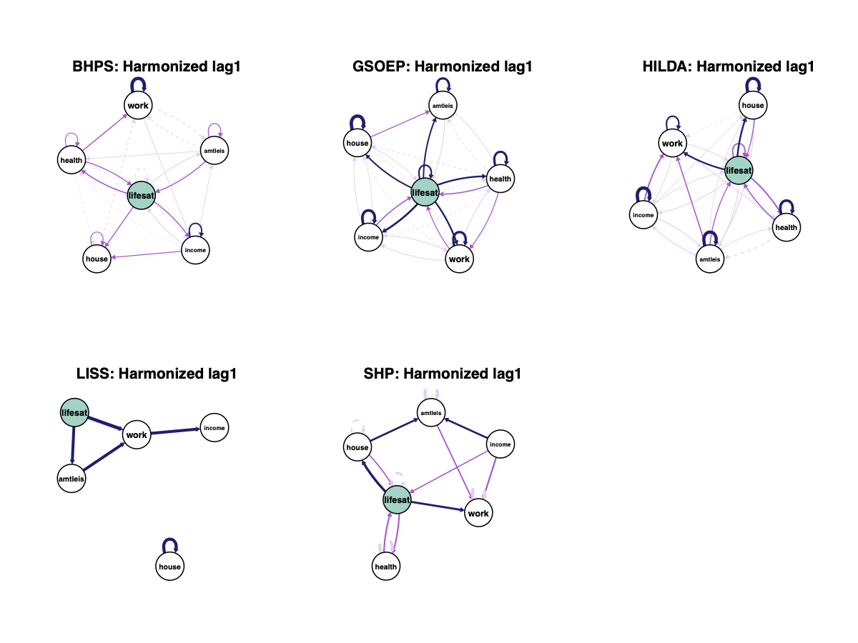
Individual Structure | Longitudinal Dynamics | Personalized Prediction | Trait Prediction
*Cheung, *Beck, Thapa, & Jackson (under review)
Notes:
So first, we can look at the average within-person effects in each of the five studies. When we do, we see bidirectional patterns of relationships between overall and domain satisfaction across the studies.

Slide 66
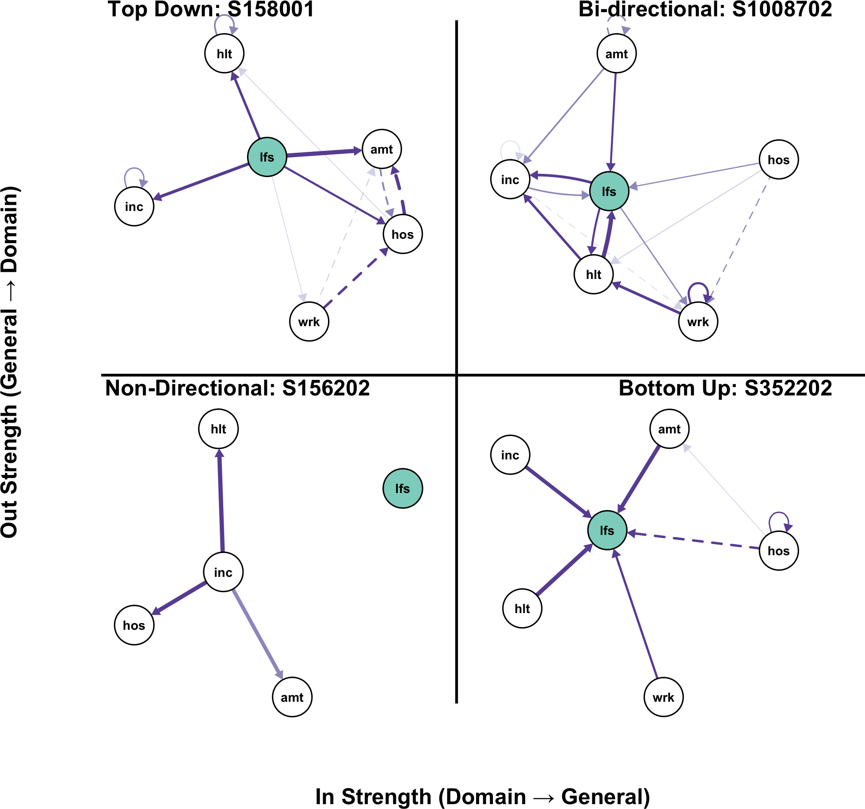
Individual Structure | Longitudinal Dynamics | Personalized Prediction | Trait Prediction
*Cheung, *Beck, Thapa, & Jackson (under review)
Notes:
But the issue with looking at average within-person effects is that it will not necessarily represent any given individual person. Indeed, there are a number of patterns that could be present even the average pattern appears to be bidirectional
And we can quantify this using network measures like in strength to life satisfaction and out strength from life satisfaction. In strength captures the degree of bottom-up associations and out-strength captures the degree of top down associations. Being high in both is bidirectional. Then, using this, we can quantify the pattern within a person and look at the proportion of individuals in each study who show different pattrns.

Slide 67
Individual Structure | Longitudinal Dynamics | Personalized Prediction | Trait Prediction
Patterns of life satisfaction are bi-directional, on average.
-- BUT --
What patterns can and do individuals show?
*Cheung, *Beck, Thapa, & Jackson (under review)
Notes:
So first, we can look at the average within-person effects in each of the five studies. When we do, we see bidirectional patterns of relationships between overall and domain satisfaction across the studies.

Slide 68
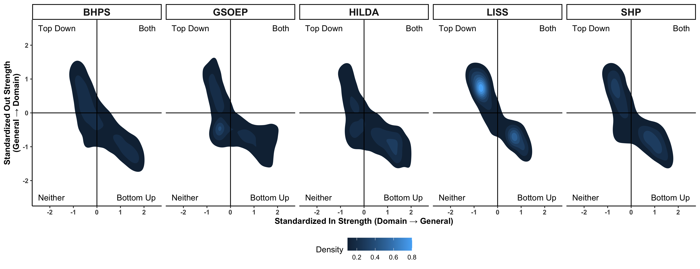
Individual Structure | Longitudinal Dynamics | Personalized Prediction | Trait Prediction
*Cheung, *Beck, Thapa, & Jackson (under review)

Slide 69

Individual Structure | Longitudinal Dynamics | Personalized Prediction | Trait Prediction
*Cheung, *Beck, Thapa, & Jackson (under review)

Slide 70
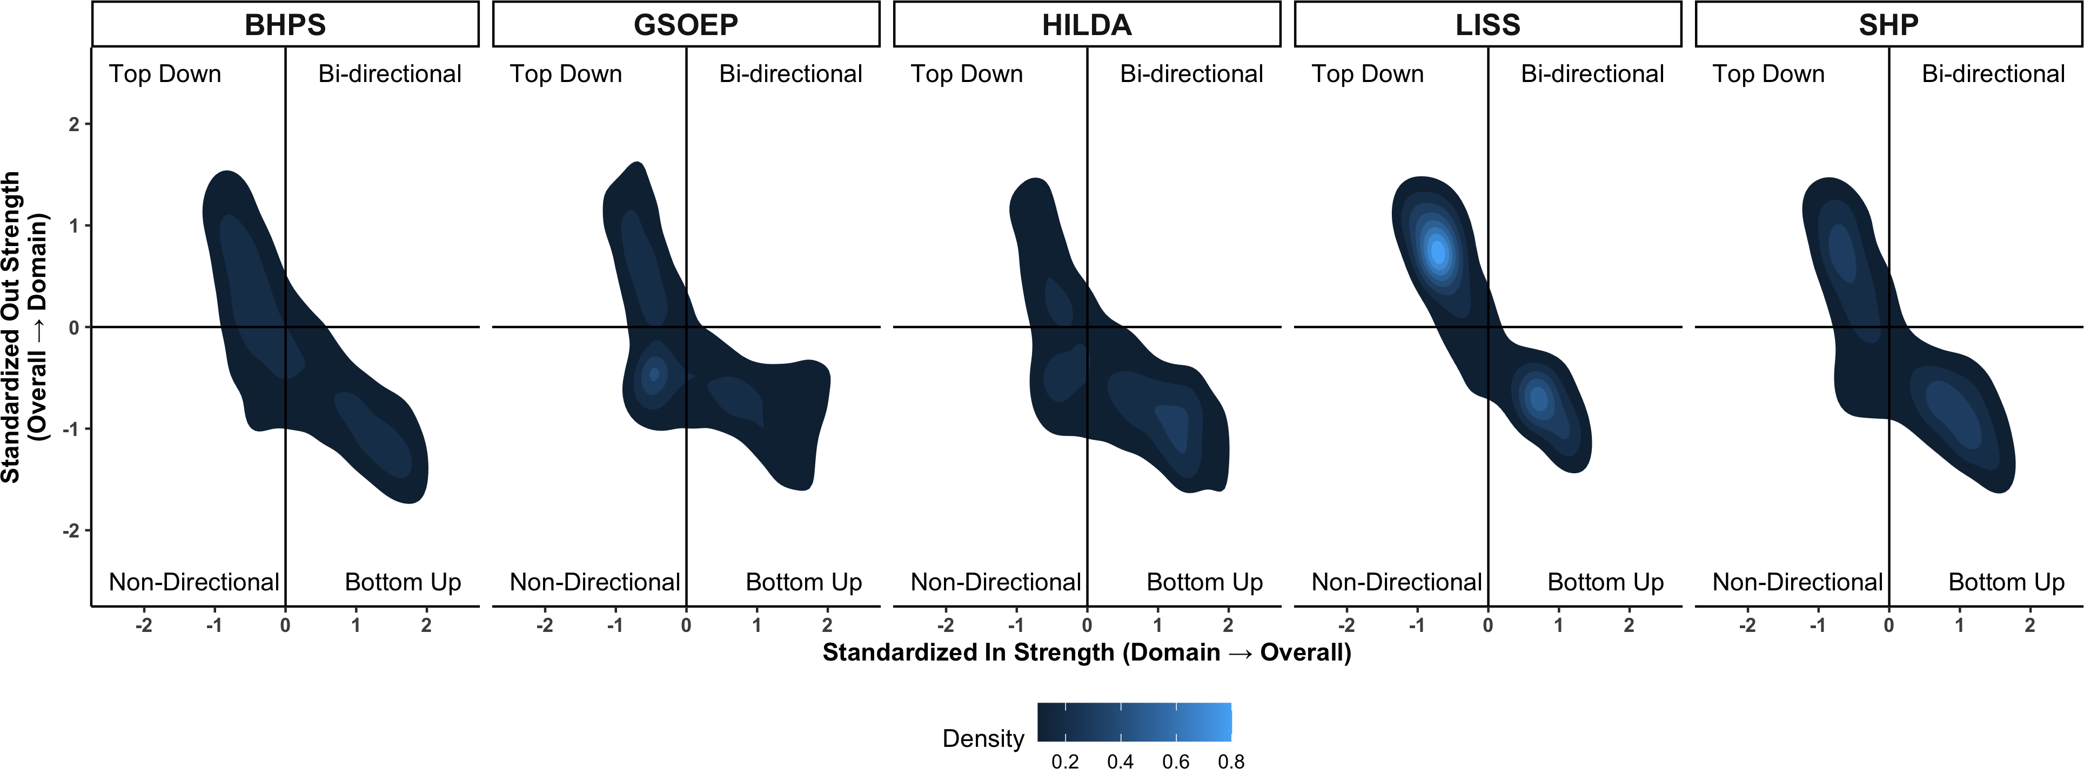
Individual Structure | Longitudinal Dynamics | Personalized Prediction | Trait Prediction
Patterns of life satisfaction may be bi-directional, on average in a sample
-- BUT --
Individuals rarely show bi-directional patterns.
*Cheung, *Beck, Thapa, & Jackson (under review)

Slide 71
Today’s Agenda
Talk
The dynamics of life and domain satisfaction:
Unfold differently across people.
Do not appear well-captured by sample averages of idiographic dynamics.
Have similar patterns of individual differences across samples
Linking Theory and Methods Using Dynamics
CAPS
Reimagining personality structure
Considering the time/context problem
Revisiting the Person-Situation Debate: A New Approach to Prediction
Estimating the Robustness of prospective personality trait-outcome associations

Slide 72


Slide 73
Today’s Agenda
Talk
Linking Theory and Methods Using Dynamics
CAPS
Reimagining personality structure
Considering the time/context problem
Revisiting the Person-Situation Debate: A New Approach to Prediction
Estimating the Robustness of prospective personality trait-outcome associations

Slide 74
Individual Structure | Longitudinal Dynamics | Personalized Prediction | Trait Prediction
Persons
Psychological
Situations
Behavior /
Experiences

Slide 75
Individual Structure | Longitudinal Dynamics | Personalized Prediction | Trait Prediction
Critical Assumption
Situations and experiences should have similar consequences across people.
People with similar levels of a personality characteristic should behave in similar ways.
Beck & Jackson (revision submitted, Psychological Science)

Slide 76
Individual Structure | Longitudinal Dynamics | Personalized Prediction | Trait Prediction
Alternative Assumption
Situations and experiences should have different consequences across people.
People with similar levels of a personality characteristic may not behave in similar ways.
Beck & Jackson (revision submitted, Psychological Science)

Slide 77

Individual Structure | Longitudinal Dynamics | Personalized Prediction | Trait Prediction
Psychological
Behaviors
Situational
Experiences
Time
Beck & Jackson (revision submitted, Psychological Science)

Slide 78
Individual Structure | Longitudinal Dynamics | Personalized Prediction | Trait Prediction
Measures
Personality & Affect
Situations
Time
Full BFI-2, administered with 75% planned missingness
Binary indicators generated by undergraduate research assistants
Derived from time stamps:
1. Time of day (morning, midday, evening, night)
Subset of the PANAS-X (items redundant with the BFI-2 removed)
0 = no, 1 = yes
Ultra-brief DIAMONDS scale
2. Day of week
0 = no, 1 = yes
5-point Likert-like scale from 1 “disagree strongly” to 5 “agree strongly.”
3-point scale from 1 “not at all” to 3 “totally.”
3. Linear, Quadratic, & Cubic Trends
4. 1 & 2 period sine and cosine
Binary indicators of procrastination, loneliness, interacting, arguments, feeling sick, feeling tired, studying
Outcomes
lead 1 (previous features predict future outcomes)
0 = no, 1 = yes
Beck & Jackson (revision submitted, Psych Science)

Slide 79
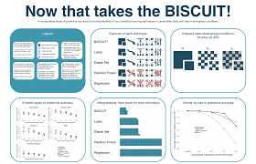
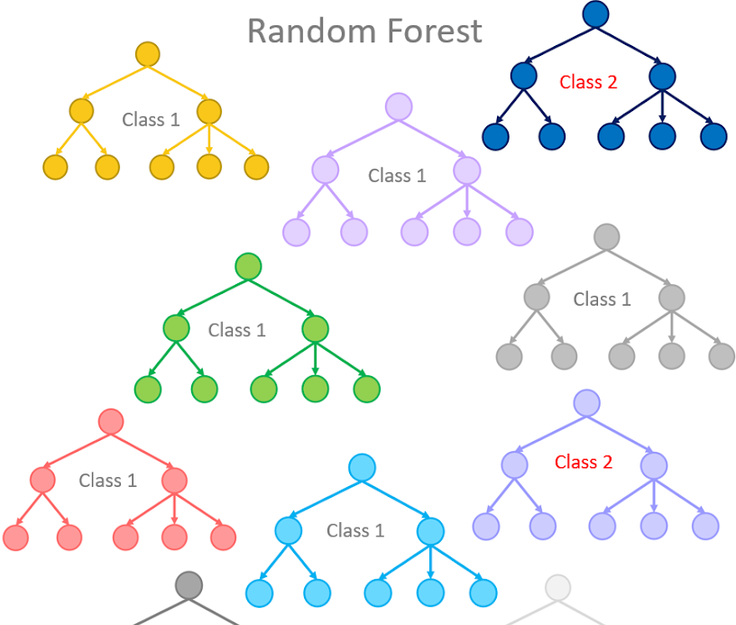
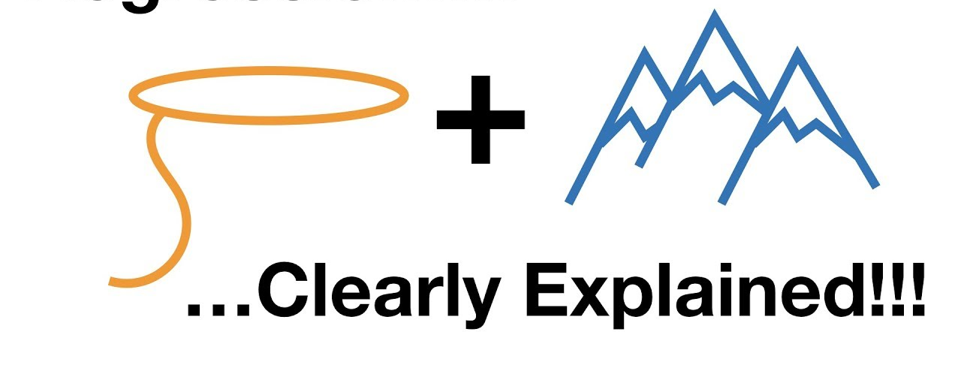
Individual Structure | Longitudinal Dynamics | Personalized Prediction | Trait Prediction
Analytic Plan
3 machine learning classification methods:
Elastic Net
BISCWIT
Random Forest
- Classification Accuracy
- Area under the receiver operating curve (AUC)
Beck & Jackson (revision submitted, Psychological Science)
Notes:
The Best Items scale that is cross-validated, correlation weighted, informative, and transparent.

Slide 80
Individual Structure | Longitudinal Dynamics | Personalized Prediction | Trait Prediction
Analytic Plan
3 machine learning classification methods:
Elastic Net
BISCWIT
Random Forest
- Classification Accuracy
- Area under the receiver operating curve (AUC)
Beck & Jackson (revision submitted, Psychological Science)
Notes:
The Best Items scale that is cross-validated, correlation weighted, informative, and transparent.

Slide 81
Analytic Plan
- Classification Accuracy
- Area under the receiver operating curve (AUC)
3 machine learning classification methods:
Elastic Net
BISCWIT
Random Forest
Tuning 𝜆 and mixture (10 values each)
Tuning number of items (number possible)
Tuning mtry (# predictors sampled) and min_n (min n to split further)
Rolling origin forecast validation: 1/3 of data as initial set, five obs validation set, skip = 1, which resulted in 10-15 rolling origin “folds.”

Slide 82
RESULTS
Aim 3

Slide 83
Individual Structure | Longitudinal Dynamics | Personalized Prediction | Trait Prediction
Classification Accuracy
 | Elastic Net |  | BISCWIT |  | Random Forest
 | Median (SD) | N | Median (SD) | N | Median (SD) | N
Procrastination | .86 (.13) | 87 | .86 (.12) | 87 | .90 (.15) | 86
Loneliness | .91 (.09) | 51 | .92 (.09) | 52 | .91 (.08) | 51
Argument | .92 (.07) | 34 | .92 (.07) | 35 | .92 (.07) | 34
Interacted | .69 (.16) | 110 | .69 (.14) | 111 | .73 (.17) | 111
Studying | .83 (.14) | 110 | .81 (.14) | 110 | .83 (.14) | 109
Sick | .91 (.10) | 56 | .91 (.11) | 56 | .91 (.13) | 56
Tired | .81 (.16) | 97 | .82 (.15) | 98 | .82 (.15) | 98
Beck & Jackson (revision submitted, Psychological Science)
Notes:
So the quick summary is that these models did predict procrastination and loneliness accurately across methods.

Slide 84
Individual Structure | Longitudinal Dynamics | Personalized Prediction | Trait Prediction
Classification Accuracy
 | Elastic Net |  | BISCWIT |  | Random Forest
 | Median (SD) | N | Median (SD) | N | Median (SD) | N
Procrastination | .86 (.13) | 87 | .86 (.12) | 87 | .90 (.15) | 86
Loneliness | .91 (.09) | 51 | .92 (.09) | 52 | .91 (.08) | 51
Argument | .92 (.07) | 34 | .92 (.07) | 35 | .92 (.07) | 34
Interacted | .69 (.16) | 110 | .69 (.14) | 111 | .73 (.17) | 111
Studying | .83 (.14) | 110 | .81 (.14) | 110 | .83 (.14) | 109
Sick | .91 (.10) | 56 | .91 (.11) | 56 | .91 (.13) | 56
Tired | .81 (.16) | 97 | .82 (.15) | 98 | .82 (.15) | 98
Classification accuracy was high, on average, with some variability across outcomes.
Beck & Jackson (revision submitted, Psychological Science)
Notes:
So the quick summary is that these models did predict procrastination and loneliness accurately across methods.

Slide 85
Individual Structure | Longitudinal Dynamics | Personalized Prediction | Trait Prediction
Classification Accuracy
 | Elastic Net |  | BISCWIT |  | Random Forest
 | Median (SD) | N | Median (SD) | N | Median (SD) | N
Procrastination | .86 (.13) | 87 | .86 (.12) | 87 | .90 (.15) | 86
Loneliness | .91 (.09) | 51 | .92 (.09) | 52 | .91 (.08) | 51
Argument | .92 (.07) | 34 | .92 (.07) | 35 | .92 (.07) | 34
Interacted | .69 (.16) | 110 | .69 (.14) | 111 | .73 (.17) | 111
Studying | .83 (.14) | 110 | .81 (.14) | 110 | .83 (.14) | 109
Sick | .91 (.10) | 56 | .91 (.11) | 56 | .91 (.13) | 56
Tired | .81 (.16) | 97 | .82 (.15) | 98 | .82 (.15) | 98
Beck & Jackson (revision submitted, Psychological Science)
Notes:
So the quick summary is that these models did predict procrastination and loneliness accurately across methods.

Slide 86
Individual Structure | Longitudinal Dynamics | Personalized Prediction | Trait Prediction
Classification Accuracy
 | Elastic Net |  | BISCWIT |  | Random Forest
 | Median (SD) | N | Median (SD) | N | Median (SD) | N
Procrastination | .86 (.13) | 87 | .86 (.12) | 87 | .90 (.15) | 86
Loneliness | .91 (.09) | 51 | .92 (.09) | 52 | .91 (.08) | 51
Argument | .92 (.07) | 34 | .92 (.07) | 35 | .92 (.07) | 34
Interacted | .69 (.16) | 110 | .69 (.14) | 111 | .73 (.17) | 111
Studying | .83 (.14) | 110 | .81 (.14) | 110 | .83 (.14) | 109
Sick | .91 (.10) | 56 | .91 (.11) | 56 | .91 (.13) | 56
Tired | .81 (.16) | 97 | .82 (.15) | 98 | .82 (.15) | 98
Classification accuracy was high, on average, with some variability across outcomes.
Beck & Jackson (revision submitted, Psychological Science)
Notes:
So the quick summary is that these models did predict procrastination and loneliness accurately across methods.

Slide 87
Individual Structure | Longitudinal Dynamics | Personalized Prediction | Trait Prediction
To what degree can we predict behavioral and experiential outcomes?
Beck & Jackson (revision submitted, Psych Science)

Slide 88
Individual Structure | Longitudinal Dynamics | Personalized Prediction | Trait Prediction
To what degree can we predict behavioral and experiential outcomes?
Beck & Jackson (revision submitted, Psych Science)

Slide 89
Individual Structure | Longitudinal Dynamics | Personalized Prediction | Trait Prediction
To what degree can we predict behavioral and experiential outcomes?
Beck & Jackson (revision submitted, Psych Science)

Slide 90
Individual Structure | Longitudinal Dynamics | Personalized Prediction | Trait Prediction
To what degree can we predict behavioral and experiential outcomes?
Beck & Jackson (revision submitted, Psych Science)

Slide 91
Individual Structure | Longitudinal Dynamics | Personalized Prediction | Trait Prediction
To what degree can we predict behavioral and experiential outcomes?
Beck & Jackson (revision submitted, Psych Science)

Slide 92
Individual Structure | Longitudinal Dynamics | Personalized Prediction | Trait Prediction
Do certain categories of features out-predict others?
Beck & Jackson (revision submitted, Psychological Science)

Slide 93
Individual Structure | Longitudinal Dynamics | Personalized Prediction | Trait Prediction
Do certain categories of features out-predict others?
Beck & Jackson (revision submitted, Psychological Science)

Slide 94
Individual Structure | Longitudinal Dynamics | Personalized Prediction | Trait Prediction
Do certain categories of features out-predict others?
Beck & Jackson (revision submitted, Psychological Science)

Slide 95
Individual Structure | Longitudinal Dynamics | Personalized Prediction | Trait Prediction
Do certain categories of features out-predict others?
The relative contribution of person, situation, and timing features varies across people.
Beck & Jackson (revision submitted, Psychological Science)

Slide 96
Individual Structure | Longitudinal Dynamics | Personalized Prediction | Trait Prediction
Do certain categories of features out-predict others?
Beck & Jackson (revision submitted, Psychological Science)

Slide 97
Individual Structure | Longitudinal Dynamics | Personalized Prediction | Trait Prediction
Do certain categories of features out-predict others?
Beck & Jackson (revision submitted, Psychological Science)

Slide 98
Individual Structure | Longitudinal Dynamics | Personalized Prediction | Trait Prediction
Do certain categories of features out-predict others?
Beck & Jackson (revision submitted, Psychological Science)

Slide 99
Individual Structure | Longitudinal Dynamics | Personalized Prediction | Trait Prediction
Do certain categories of features out-predict others?
Beck & Jackson (revision submitted, Psychological Science)

Slide 100
Individual Structure | Longitudinal Dynamics | Personalized Prediction | Trait Prediction
Do certain categories of features out-predict others?
The relative contribution of person, situation, and timing features varies across people.
Beck & Jackson (revision submitted, Psychological Science)

Slide 101
Individual Structure | Longitudinal Dynamics | Personalized Prediction | Trait Prediction
Which features play the strongest roles?
Beck & Jackson (revision submitted, Psych Science)

Slide 102
Individual Structure | Longitudinal Dynamics | Personalized Prediction | Trait Prediction
Which features play the strongest roles?
5
10
15
20
25

Slide 103
Individual Structure | Longitudinal Dynamics | Personalized Prediction | Trait Prediction
Which features play the strongest roles?
24 hr sine
Energy Level
Openness:
Intellectual Curiosity
Aesthetic Sensitivity
Emotional Volatility
Happy
5
10
Tired
Attentive
15
20
25
Sociality

Slide 104
Background Characteristics | Changing Environments | Domains and Dispositions | Detecting Life Events | Persons versus Situations | Future Directions
Which features play the strongest roles?
Intellectual
Curiosity
pOsitivity
Negativity

Slide 105
Individual Structure | Longitudinal Dynamics | Personalized Prediction | Trait Prediction
Which features play the strongest roles?
24 hr sine
5
10
15
20
25

Slide 106
Individual Structure | Longitudinal Dynamics | Personalized Prediction | Trait Prediction
Which features play the strongest roles?
Internet
Use
Duty
Intellect
5
10
Sociality
15
20
25

Slide 107
Individual Structure | Longitudinal Dynamics | Personalized Prediction | Trait Prediction
Which features play the strongest roles?
No one feature dominated the prediction of any outcome (max ~35%).
Behaviors & experiences have unique antecedents.
Internet
Use
Duty
Intellect
5
10
Sociality
15
20
25

Slide 108
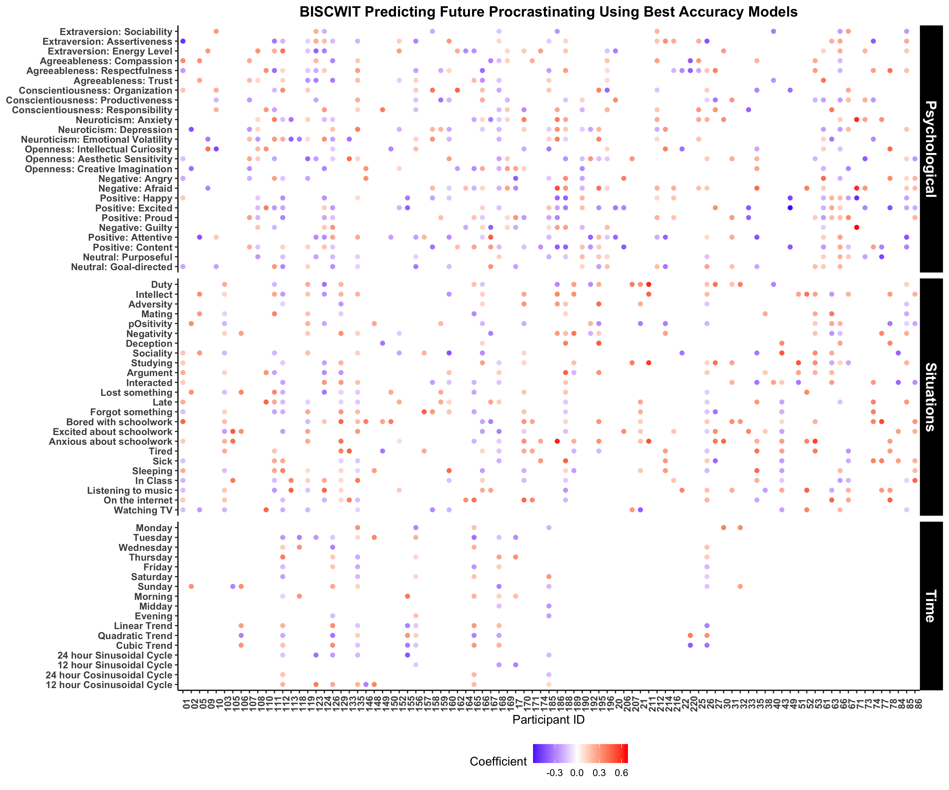
Individual Structure | Longitudinal Dynamics | Personalized Prediction | Trait Prediction
Notes:
The observation that we can predict behaviors and experiences, like procrastination and loneliness, as well as other behaviors and experience not shown today like interacting with others, arguing with others, feeling sick, feeling tired, and studying, is promising, particularly given a long history of difficulty predicting individual behaviors and experiences.
But the diversity and variability in which of the features also has implications for work on behavior change, suggesting that to change behaviors, we may need to first understand the unique antecedents of an individual

Slide 109
Individual Structure | Longitudinal Dynamics | Personalized Prediction | Trait Prediction
Individuals’ profiles of antecedents differed in presence and direction.
Notes:
The observation that we can predict behaviors and experiences, like procrastination and loneliness, as well as other behaviors and experience not shown today like interacting with others, arguing with others, feeling sick, feeling tired, and studying, is promising, particularly given a long history of difficulty predicting individual behaviors and experiences.
But the diversity and variability in which of the features also has implications for work on behavior change, suggesting that to change behaviors, we may need to first understand the unique antecedents of an individual

Slide 110
Today’s Agenda
Talk
The antecedents of behaviors and experiences:
Can be used to accurately predict those behaviors and experiences
Differ across people
Vary in the degree of psychological, situational, and timing antecedents
Linking Theory and Methods Using Dynamics
CAPS
Reimagining personality structure
Considering the time/context problem
Revisiting the Person-Situation Debate: A New Approach to Prediction
Estimating the Robustness of prospective personality trait-outcome associations

Slide 111
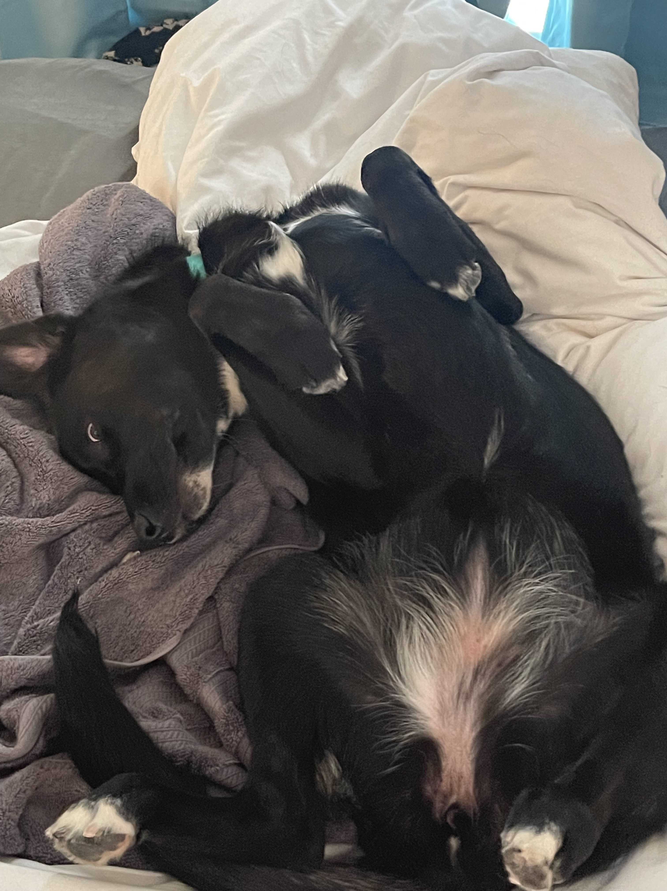

Slide 112
Today’s Agenda
Talk
Linking Theory and Methods Using Dynamics
CAPS
Reimagining personality structure
Considering the time/context problem
Revisiting the Person-Situation Debate: A New Approach to Prediction
Estimating the Robustness of prospective personality trait-outcome associations

Slide 113
Selection
Extra-version
Agreeab-leness
Consci-entious-ness
Neurot-icism
Open-ness
Self-Esteem
Optim-ism
Life Satis-faction
Positive Affect
Negat-ive Affect
Locus of Control
Social Support
IQ
Depress-ion
Move in with Partner (+)
(Specht et al., 2011)
Become Unemp-loyed (+)
(Specht et al., 2011)
Mortality (-)
(Specht et al., 2011)
Mortality (+)
(Specht et al., 2011)
First Job (-)
(Lüdtke et al., 2011)
Criminal Behavior (-)
(Trzesniewski et al., 2006)
Heart Problems(-)
(Tindle et al., 2009)
Mortality (-)
(Lyyra et al., 2006)
Inflam-matory markers
(-)
(Specht et al., 2011)
Post-traumatic Stress (+)
(Weems et al., 2007)
Survival after Trans-plant (+)
(Burker et al., 2005)
Mortality (-)
(Brown et al., 2003)
Longevity (+)
(Gottfredson & Deary, 2004)
Heart Failure (+)
(Johnson et al., 2012)
Have Children (+)
(van Scheppingen et al, 2016)
Separate Partner
(-)
(van Scheppingen et al, 2016)
Health (+)
(van Scheppingen et al, 2016)
Health (-)
(van Scheppingen et al, 2016)
End Relation-ship (+)
(Lüdtke et al., 2011)
Smoking (-)
(Trzesniewski et al., 2006)
Marital wellbeing
(+)
(Neff & Geers, 2013)
Divorce
(-)
(Stutzer & Frey, 2006)
Physical Activity (+)
(Audrain et al., 2001)
Common Cold (+)
(Cohen et al., 1993)
Social Mobility (+)
(von Stumm et al, 2009)
Inflam-mation (-)
(Hughes et al., 2014)
Smoking (-)
(Gottfredson, 2004)
Mortality (+)
(Sullivan et al., 2012)
Romantic Relation-ships (+)
(Wagner et al., 2015)
Do Military Service (-)
Jackson et al., 2012)
Work Exper-iences (+)
(Lüdtke et al., 2011)
Leave Parents’ Home (+)
(Lüdtke et al., 2011)
Retire-ment (+)
(Specht et al., 2011)
Heart Problems (-)
(Trzesniewski et al., 2006)
Complet-ing College (-)
(Solberg Ness et al., 2009)
Student Engage-ment(+)
(Heffner & Antaramanian, 2015)
Smoking (-)
(Pettit et al., 2001)
Blood pressure (+)
(Ewart & Kolodner, 1994)
School Achieve-ment (+)
(Tesiny et al., 1980)
Delinq-uency (-)
Kort-Butler, 2010)
Obesity
(-)
(Gottfredson, 2004)
Smoking (+)
(Japuntich et al., 2007)

Slide 114
Limitations of Personality Prediction
Cross-Sectional (Reverse Causality) | Third Variables (Selection Bias) | Arbitrary Covariate Inclusion | Unclear Boundary Conditions | Single Studies
Personality
T0
T1
T2
Outcomes
Outcomes
Notes:
Much of the work linking personality to experiences does so cross sectionally, looking at how concurrent measures of personality predict life events experienced up that point (e.g. are you married)

Slide 115
Limitations of Personality Prediction
Cross-Sectional (Reverse Causality) | Third Variables (Selection Bias) | Arbitrary Covariate Inclusion | Unclear Boundary Conditions | Single Studies
Personality
T0
T1
T2
Outcomes
Outcomes
Notes:
Much of the work linking personality to experiences does so cross sectionally, looking at how concurrent measures of personality predict life events experienced up that point (e.g. are you married)

Slide 116
Limitations of Personality Prediction
Cross-Sectional (Reverse Causality) | Third Variables (Selection Bias) | Arbitrary Covariate Inclusion | Unclear Boundary Conditions | Single Studies
Personality
T0
T1
T2
Outcomes
Outcomes
Notes:
Much of the work linking personality to experiences does so cross sectionally, looking at how concurrent measures of personality predict life events experienced up that point (e.g. are you married)

Slide 117
Limitations of Personality Prediction
Cross-Sectional (Reverse Causality) | Third Variables (Selection Bias) | Arbitrary Covariate Inclusion | Unclear Boundary Conditions | Single Studies
Personality
T0
T1
T2
Outcomes
Outcomes
Notes:
Much of the work linking personality to experiences does so cross sectionally, looking at how concurrent measures of personality predict life events experienced up that point (e.g. are you married)

Slide 118
Limitations of Personality Prediction
Cross-Sectional (Reverse Causality) | Third Variables (Selection Bias) | Arbitrary Covariate Inclusion | Unclear Boundary Conditions | Single Studies
Inattention to Third Variables (Selection Bias)
Income
Social
Personality
Age
Early Life
Health
Education
Family
T0
T1
T2
Outcomes
Outcomes
Notes:
Much of the work linking personality to experiences does so cross sectionally, looking at how concurrent measures of personality predict life events experienced up that point (e.g. are you married)

Slide 119
Limitations of Personality Prediction
Cross-Sectional (Reverse Causality) | Third Variables (Selection Bias) | Arbitrary Covariate Inclusion | Unclear Boundary Conditions | Single Studies
Income
Social
Personality
Age
Early Life
Health
Education
Family
T0
T1
T2
Outcomes
Outcomes
Notes:
Much of the work linking personality to experiences does so cross sectionally, looking at how concurrent measures of personality predict life events experienced up that point (e.g. are you married)

Slide 120
Limitations of Personality Prediction
Cross-Sectional (Reverse Causality) | Third Variables (Selection Bias) | Arbitrary Covariate Inclusion | Unclear Boundary Conditions | Single Studies
Income
Social
Personality
Age
Early Life
Health
Education
Family
T0
T1
T2
Outcomes
Outcomes
Notes:
Much of the work linking personality to experiences does so cross sectionally, looking at how concurrent measures of personality predict life events experienced up that point (e.g. are you married)

Slide 121
Limitations of Personality Prediction
Cross-Sectional (Reverse Causality) | Third Variables (Selection Bias) | Arbitrary Covariate Inclusion | Unclear Boundary Conditions | Single Studies
Income
Social
Personality
Age
Early Life
Health
Education
Family
T0
T1
T2
Outcomes
Outcomes
Notes:
Much of the work linking personality to experiences does so cross sectionally, looking at how concurrent measures of personality predict life events experienced up that point (e.g. are you married)

Slide 122
Limitations of Personality Prediction
Cross-Sectional (Reverse Causality) | Third Variables (Selection Bias) | Arbitrary Covariate Inclusion | Unclear Boundary Conditions | Single Studies
Income
Social
Personality
Age
Early Life
Health
Education
Family
T0
T1
T2
Outcomes
Outcomes
Notes:
Much of the work linking personality to experiences does so cross sectionally, looking at how concurrent measures of personality predict life events experienced up that point (e.g. are you married)

Slide 123
Limitations of Personality Prediction
Cross-Sectional (Reverse Causality) | Third Variables (Selection Bias) | Arbitrary Covariate Inclusion | Unclear Boundary Conditions | Single Studies
Income
Social
Personality
Age
Early Life
Health
Education
Family
T0
T1
T2
Outcomes
Outcomes
Notes:
Much of the work linking personality to experiences does so cross sectionally, looking at how concurrent measures of personality predict life events experienced up that point (e.g. are you married)

Slide 124
The Current Study
How robust are personality-outcome associations…
Longitudinally?
Across studies?
Controlling for selection bias?
Across moderators?
Across covariates?
Preregistration: https://osf.io/tcysh

Slide 125
14 Predictors | 14 Outcomes | 8 Moderators | 10 Studies
Extraversion | Mortality | Age | Add Health
Agreeableness | Major Health Event | Gender | BHPS (and US)
Conscientiousness | Mental Health Event | Race | GSOEP
Neuroticism | Childbirth | Parental Education (SES) | HILDA
Openness to Experience | Move in with a Partner | Par. Occ. Prestige (SES) | HRS
Self-Esteem | Marriage | Gross Wages (SES) | LISS
Optimism / Pessimism | Divorce | Reliability | MIDUS
Satisfaction with Life | Child Moves Out | Prediction Interval | NLSY
Positive Affect | Higher Education |  | SHP
Negative Affect | First Job | 2 Methods | WLS (G&S)
Locus of Control | Unemployment | Propensity Score Matching
Social Support | Retirement | Specification Curve Analysis
IQ | Volunteering
Depression | Criminal Behavior
Health
Social
Work/Edu
Civic
Notes:
NOT GOING TO SPEND TIME GOING OVER MEASURES IN DETAIL HERE BUT HAPPY TO ANSWER QUESTIONS ABOUT IT

Slide 126
14 Predictors | 14 Outcomes | 8 Moderators | 10 Studies
Extraversion | Mortality | Age | Add Health
Agreeableness | Major Health Event | Gender | BHPS (and US)
Conscientiousness | Mental Health Event | Race | GSOEP
Neuroticism | Childbirth | Parental Education (SES) | HILDA
Openness to Experience | Move in with a Partner | Par. Occ. Prestige (SES) | HRS
Self-Esteem | Marriage | Gross Wages (SES) | LISS
Optimism / Pessimism | Divorce | Reliability | MIDUS
Satisfaction with Life | Child Moves Out | Prediction Interval | NLSY
Positive Affect | Higher Education |  | SHP
Negative Affect | First Job | 2 Methods | WLS (G&S)
Locus of Control | Unemployment | Propensity Score Matching
Social Support | Retirement | Specification Curve Analysis
IQ / Cognitive Ability | Volunteering
Depression | Criminal Behavior
Health
Social
Work/Edu
Civic

Slide 127
14 Predictors | 14 Outcomes | 8 Moderators | 10 Studies
Extraversion | Mortality | Age | Add Health
Agreeableness | Major Health Event | Gender | BHPS (and US)
Conscientiousness | Mental Health Event | Race | GSOEP
Neuroticism | Childbirth | Parental Education (SES) | HILDA
Openness to Experience | Move in with a Partner | Par. Occ. Prestige (SES) | HRS
Self-Esteem | Marriage | Gross Wages (SES) | LISS
Optimism / Pessimism | Divorce | Reliability | MIDUS
Satisfaction with Life | Child Moves Out | Prediction Interval | NLSY
Positive Affect | Higher Education |  | SHP
Negative Affect | First Job | 2 Methods | WLS (G&S)
Locus of Control | Unemployment | Propensity Score Matching
Social Support | Retirement | Specification Curve Analysis
IQ / Cognitive Ability | Volunteering
Depression | Criminal Behavior
Health
Social
Work/Edu
Civic

Slide 128
14 Predictors | 14 Outcomes | 8 Moderators | 10 Studies
Extraversion | Mortality | Age | Add Health
Agreeableness | Major Health Event | Gender | BHPS (and US)
Conscientiousness | Mental Health Event | Race | GSOEP
Neuroticism | Childbirth | Parental Education (SES) | HILDA
Openness to Experience | Move in with a Partner | Par. Occ. Prestige (SES) | HRS
Self-Esteem | Marriage | Gross Wages (SES) | LISS
Optimism / Pessimism | Divorce | Reliability | MIDUS
Satisfaction with Life | Child Moves Out | Prediction Interval | NLSY
Positive Affect | Higher Education |  | SHP
Negative Affect | First Job | 2 Methods | WLS (G&S)
Locus of Control | Unemployment | Propensity Score Matching
Social Support | Retirement | Specification Curve Analysis
IQ / Cognitive Ability | Volunteering
Depression | Criminal Behavior
Health
Social
Work/Edu
Civic

Slide 129
14 Predictors | 14 Outcomes | 8 Moderators | 10 Studies
Extraversion | Mortality | Age | Add Health
Agreeableness | Major Health Event | Gender | BHPS (and US)
Conscientiousness | Mental Health Event | Race | GSOEP
Neuroticism | Childbirth | Parental Education (SES) | HILDA
Openness to Experience | Move in with a Partner | Par. Occ. Prestige (SES) | HRS
Self-Esteem | Marriage | Gross Wages (SES) | LISS
Optimism / Pessimism | Divorce | Reliability | MIDUS
Satisfaction with Life | Child Moves Out | Prediction Interval | NLSY
Positive Affect | Higher Education |  | SHP
Negative Affect | First Job | 2 Methods | WLS (G&S)
Locus of Control | Unemployment | Propensity Score Matching
Social Support | Retirement | Specification Curve Analysis
IQ / Cognitive Ability | Volunteering
Depression | Criminal Behavior
Health
Social
Work/Edu
Civic

Slide 130
14 Predictors | 14 Outcomes | 8 Moderators | 10 Studies
Extraversion | Mortality | Age | Add Health
Agreeableness | Major Health Event | Gender | BHPS (and US)
Conscientiousness | Mental Health Event | Race | GSOEP
Neuroticism | Childbirth | Parental Education (SES) | HILDA
Openness to Experience | Move in with a Partner | Par. Occ. Prestige (SES) | HRS
Self-Esteem | Marriage | Gross Wages (SES) | LISS
Optimism / Pessimism | Divorce | Reliability | MIDUS
Satisfaction with Life | Child Moves Out | Prediction Interval | NLSY
Positive Affect | Higher Education |  | SHP
Negative Affect | First Job | 2 Methods | WLS (G&S)
Locus of Control | Unemployment | Propensity Score Matching
Social Support | Retirement | Specification Curve Analysis
IQ / Cognitive Ability | Volunteering
Depression | Criminal Behavior
Health
Social
Work/Edu
Civic

Slide 131

No Event
Event
Propensity Score Matching
(Thoemmes & Kim, 2011)
Notes:
But I didn’t, so I’m stuck looking for an alternative solution.
Technique called propensity score matching. Essentially take a bunch of predictors and use them to predict an outcome. Then use these predictions (so-called propensity scores for each person) and start matching people with the same propensities who did and didn’t experience events.

Slide 132
No Event
Event
PS = .2
(Thoemmes & Kim, 2011)

Slide 133
No Event
Event
PS = .2
PS = .6
(Thoemmes & Kim, 2011)

Slide 134
No Event
Event
PS = .2
PS = .6
PS = .9
(Thoemmes & Kim, 2011)

Slide 135
No Event
Event
PS = .2
PS = .6
PS = .9
PS = .3
(Thoemmes & Kim, 2011)

Slide 136
No Event
Event
PS = 1.2
PS = .6
PS = .9
PS = .4
PS = .3
PS = .7
PS = .6
PS = 1.0
PS = .1
PS = .9
(Thoemmes & Kim, 2011)
Notes:
Note that not everyone may have a match. Propensity scores don’t tend to be equal across groups. People who can’t be matched are left out.

Slide 137
Propensity Score Matching
Year of Birth | Physical Functioning | Unemployment Benefit
Gender | Life Satisfaction | Number of Siblings
Household ID | Satisfaction with Family | Married
Father Alive | Satisfaction with Income | Number of Children
Mother Alive | Satisfaction with School | Employment
Race | Neighborhood Quality | Height (in meters)
Ethnicity | Healthcare | Weight (in kg)
Gross Wages | Urban/Rural | Education
Welfare | Disability | Exercise
Household size | Father Education | Drinks Alcohol
Self-Rated Physical Health | Mother Education | Does Drugs
Body Mass Index (BMI) | Mother Age at Birth | Smokes
Loneliness | Doctor Visits | Physical Activity

Slide 138
Results
Propensity Score Matching
R Shiny Web Application: https://emoriebeck.shinyapps.io/selection
All Code & Results: https://github.com/emoriebeck/selection

Slide 139
PSM Balance | Unmoderated Prediction | Moderators of Prediction

Slide 140
PSM Balance | Unmoderated Prediction | Moderators of Prediction
emoriebeck.shinyapps.io/selection

Slide 141
Individual Structure | Longitudinal Dynamics | Personalized Prediction | Trait Prediction
emoriebeck.shinyapps.io/selection
https://github.com/emoriebeck/selection/tree/master/results/psm/bal_plots

Slide 142
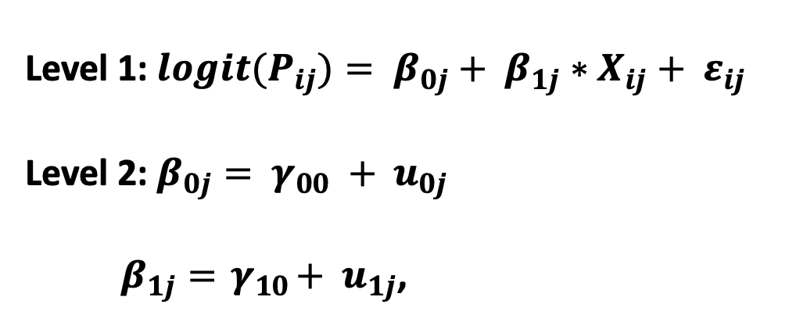
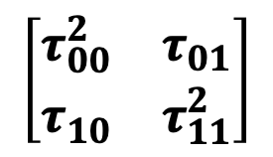
Individual Structure | Longitudinal Dynamics | Personalized Prediction | Trait Prediction
Level 1: ${logit(P}_{ij})= β_{0j}+ β_{1j}∗X_{ij}+ ε_{ij}$
Level 2: $β_{0j}= γ_{00} + u_{0j}$
$β_{1j}={ γ}_{10}+ { u}_{1j}$,
Dataset
Wisconsin Longitudinal Study (WLS)
German Socioeconomic Panel (GSOEP)
Longitudinal Internet Studies for the Social Sciences (LISS)
National Longitudinal Study of Youth (NLSY)
Household, Income, and Labor Dynamics in Australia (HILDA)
Midlife in the US Study (MIDUS)
British House Panel Study (BHPS)
Adolescent to Adult Health (Ad Health)
Health and Retirement Study (HRS)
Swiss Household Panel Study (SHP)
$$\left[\begin{matrix}τ_{00}^{2} & τ_{01} \\ τ_{10} & τ_{11}^{2}\end{matrix}\right]$$
Study-specific personality-outcome associations
Average personality-outcome association
Study-specific deviations
Variance in personality-outcome associations

Slide 143
Individual Structure | Longitudinal Dynamics | Personalized Prediction | Trait Prediction
Mega-Analytic Estimates ($γ_{10}$): 32.65% robust after matching
https://github.com/emoriebeck/selection/tree/master/results/psm/matched/tables

Slide 144
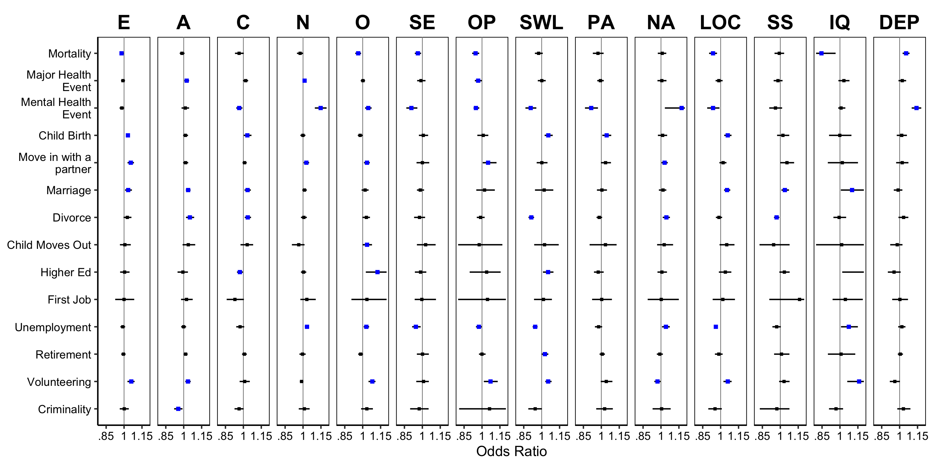
Individual Structure | Longitudinal Dynamics | Personalized Prediction | Trait Prediction
Mega-Analytic Estimates ($γ_{10}$): 32.65% robust after matching
Health
Social
Work/Edu
Civic

Slide 145
Individual Structure | Longitudinal Dynamics | Personalized Prediction | Trait Prediction
Mega-Analytic Estimates ($γ_{10}$): 32.65% robust after matching
Health
Social
Work/Edu
Civic

Slide 146
Individual Structure | Longitudinal Dynamics | Personalized Prediction | Trait Prediction
Study-Specific Estimates ($β_{1J}$)
https://github.com/emoriebeck/selection/tree/master/results/psm/matched/tables

Slide 147
Individual Structure | Longitudinal Dynamics | Personalized Prediction | Trait Prediction
Study-Specific Estimates ($β_{1J}$)
https://github.com/emoriebeck/selection/tree/master/results/psm/matched/tables

Slide 148
Individual Structure | Longitudinal Dynamics | Personalized Prediction | Trait Prediction
Study-Specific Estimates ($β_{1J}$)
https://github.com/emoriebeck/selection/tree/master/results/psm/matched/tables

Slide 149
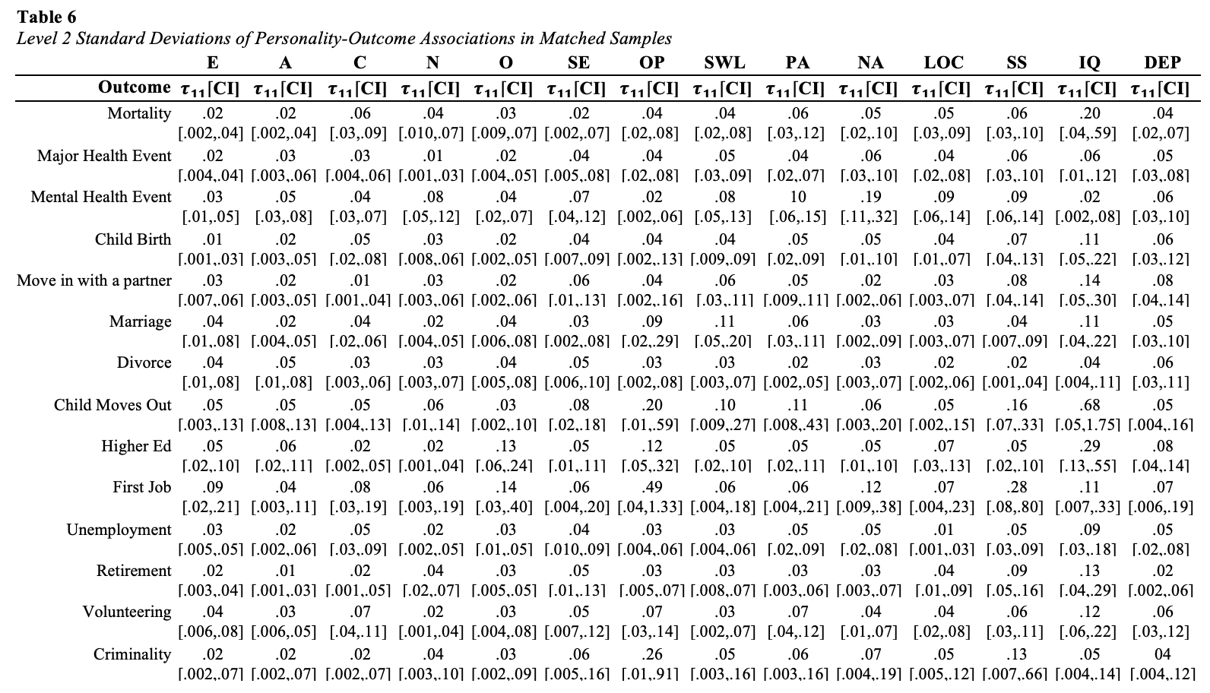
PSM Balance | Unmoderated Prediction | Moderators of Prediction
Health
Social
Work/Edu
Civic

Slide 150
Individual Structure | Longitudinal Dynamics | Personalized Prediction | Trait Prediction
…too many results to parse through in a short amount of time
Top/Bottom Moderators
Most/Least
Moderated Traits
Most/Least
Moderated Outcomes

Slide 151
Individual Structure | Longitudinal Dynamics | Personalized Prediction | Trait Prediction
…too many results to parse through in a short amount of time
Top/Bottom Moderators
Most/Least
Moderated Traits
Most/Least
Moderated Outcomes
6.70% significant overall
Parental Education: 11.20%*
Age: 10.20%
Gender: 9.80%
…
Race: 3.57%**
Reliability: 1.02%
14/14 moderated
Social Support: 12.50%
Conscientiousness, Openness: 10.70%
…
IQ: 3.57%
Optimism: 2.68%
11/14 moderated
Unemployment: 13.4%
Move in with a Partner: 10.7%
…
Education: 3.57%
Child Moves Out, First Job, Criminal Behavior: 0%
*high school or below versus either 2/4-year college, 8.16%; degree or beyond 4 years of college, 4.08%
**white versus Black, 3.06%; white versus other; .51%

Slide 152
Today’s Agenda
Talk
Personality traits:
Robustly predict life outcomes across samples
Have few reliable moderators of those associations
Persist even when adjusting for background characteristics via PSM
Linking Theory and Methods Using Dynamics
CAPS
Reimagining personality structure
Considering the time/context problem
Revisiting the Person-Situation Debate: A New Approach to Prediction
Estimating the Robustness of prospective personality trait-outcome associations

Slide 153
Today’s Agenda
Talk
Linking Theory and Methods Using Dynamics
CAPS
Reimagining personality structure
Individuals show unique personality structures that are relatively consistent across time and events but bear little resemblance to between-person structure.
Considering the time/context problem
The dynamics of well-being unfold differently across people in ways that our theories don’t currently account for.
Revisiting the Person-Situation Debate: A New Approach to Prediction
Psychological and situational antecedents of behaviors and experiences vary across people.
Estimating the Robustness of prospective personality trait-outcome associations
Personality traits are robust predictors of later life outcomes.

Slide 154
Today’s Agenda
Talk
Seminar
Workshop
Linking Theory and Methods Using Dynamics
Revisiting Assessment and Its Link to Dynamics
Applying (some) Dynamic Models to Real Data
CAPS
Methods from the Talk
Reimagining personality structure
Deconstructing Definitions
(Basic) Time Series
Core Dynamics Metrics
Considering the time/context problem
Small Group Work
Multilevel “Process” Models
Revisiting the Person-Situation Debate: A New Approach to Prediction
Presentation and Integration
(Applied) Machine Learning
Dynamic EGA
Estimating the Robustness of prospective personality trait-outcome associations
(Maybe) Growth Models

